Slide 1
RENASYS™ TOUCH
Negative Pressure Wound Therapy System

Slide 2
RENASYS™ TOUCH
Agenda
Overview
Device features
Canisters
  Canister selection
  Canister installation
  Removing/changing the canister
Functionality
Alarms
RENASYS TOUCH accessories
Maintenance and service
RENASYS TOUCH specific precautions
Product quiz
Demonstration

Slide 3
RENASYS™ TOUCH overview
Pump features
RENASYS TOUCH combines an intuitive¹ design with power and flexibility, facilitating effective therapy whilst supporting individualised patient care from the hospital to the home.
Pump dimensions | 180 x 190 x 76mm with 300ml canister
Weight | 1.1kg with 300ml canister
Canisters | 300ml or 800ml
Mode of operation | Continuous/intermittent / Adjustable intermittent
Vacuum range | -25 to -200mmHg
Indicators | Vacuum, leak, blockage, battery, canister full, device failure, inactive, maintenance
Power source | Lithium ion rechargeable
Battery operation | 10-16 hours therapy when operating from -25mmHg to -120mmHg. 8 hours (therapy) at -200mmHg
Charging time | Up to 3 hours
Module 3c
Notes:
RENASYS TOUCH is a compact and lightweight device weighting 1.1kg with a 300ml canister; making it easy to use in any care settings, from hospital to home.
300mL and 800mL canisters are available, reducing the need to use different models of NPWT devices whilst supporting a wide range of wound types and care settings
Clinicians have a flexible range of therapy settings optimised for variety of wound types and prescribed therapies.
Clinicians can adjust the therapy modes to continuous, intermittent or variable intermittent ranging from -25mmHg to -200mmHg to fit the individual patient needs
A range of alarms have been intergrated to minimse disruption in therapy and are supported with built-in troubleshooting guides
The device has an integrated Lithium Ion rechargeable battery that can provide up to 16 hours of therapy when operating between -25mmHg and -120mmHg, providing therapy that can last throughout the day and reducing the risk of battery depletion
The device can also operate whilst charging. It should take no more than 3 hours to fully recharge the battery

Slide 4
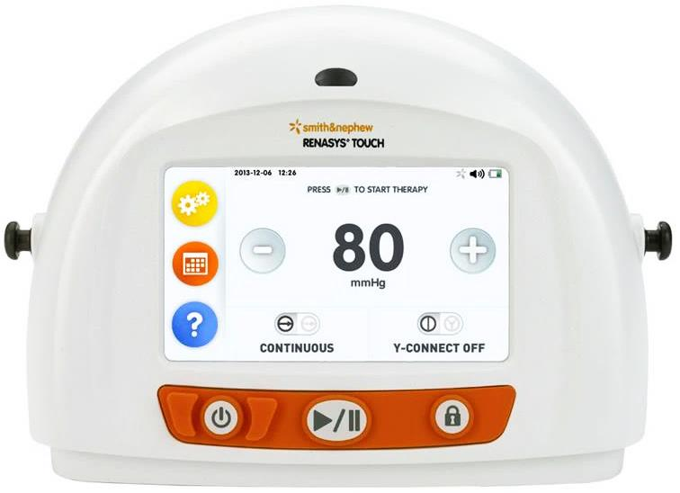
RENASYS™ TOUCH features
Front view
Status indicator
Green: therapy active
Yellow: alarm state
Colour touchscreen display
Easy to navigate with intuitive icons
Module 3c
Attachment knobs
for carry straps
Button panel:
Power (left)
Start/Pause Therapy (centre)
Lock interface (right)

Slide 5
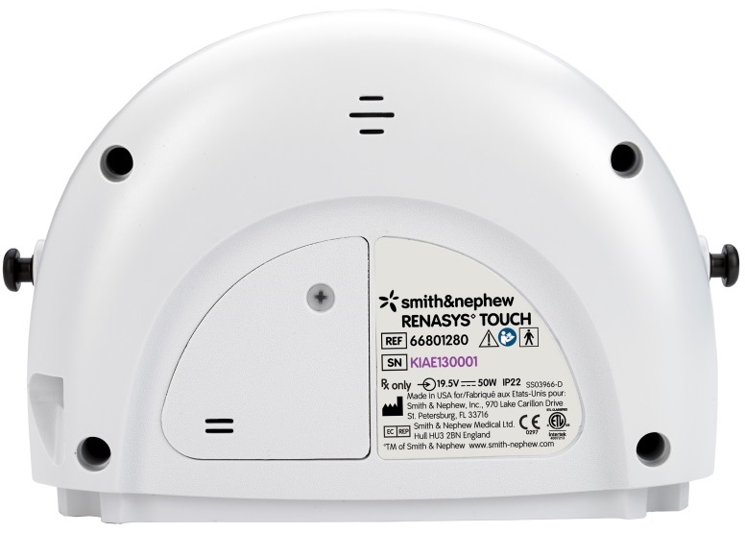
RENASYS™ TOUCH features
Back view
Access door
Odour filter, USB port and air exhaust outlet
Speaker
Audio Alarm
Module 3c
Contoured shape
with easy-grip features
Power
Power jack and external power indicator
Device labels

Slide 6
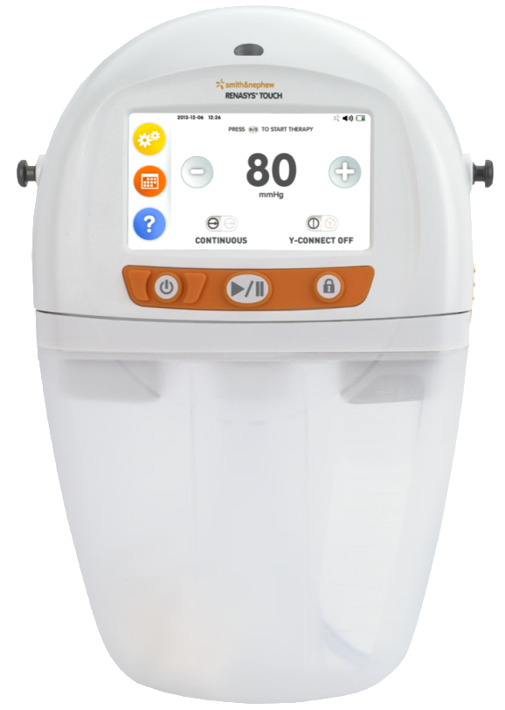
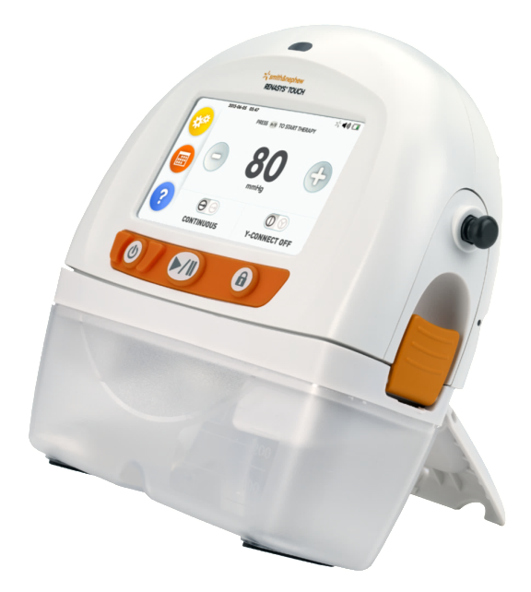

Canisters
Selection
Size of canister | 300ml | 800ml
No. canisters per case | 5 | 5
Overflow guard with silicone tubing
Solidifier
Canister tubing
Product code | 66801273 | 66801274
Module 3c
Canister clip
Rubber feet
Kickstand
Canister viewing window
For patients with high risk of bleeding use 300ml canister. Ensure the 300ml canister viewing window is checked frequently for signs of bleeding.

Slide 7

Canisters
Selection
RENASYS™ TOUCH canisters use an integral two stage bacterial filter for protection of the device against overflow and the spread of aspirated micro-organisms.
Canisters are non-sterile and should not be used in the sterile field.
Canisters are single use devices. DO NOT REUSE.
Canisters should be changed at least once a week, whenever there is a change in patient condition or in the event the canister contents reach maximum volume indication (300ml or 800ml fill line) in the viewing window.
NOTE: Do not wait for canister over-capacity alarm activation to change canister.
For patients with high risk of bleeding, use the 300ml canister. Canisters may have to be changed regularly within single patient treatments if exudate levels are high. Check canisters regularly to monitor exudate levels, ensuring they are below the canister maximum volume indication.
Check canister for any signs of cracks or damage. If noted, discard and replace canister.
Change or replace canisters that have been dropped or mishandled even if no visible signs of damage are present to ensure correct operation of software alarms for leak and blockage.
Module 3c
Refer to instructions for use provided with canisters for additional information on canister installation and use.

Slide 8
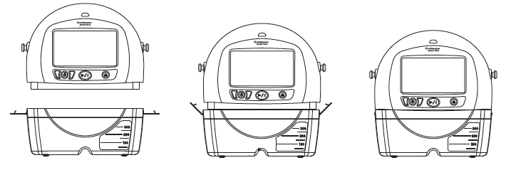
Canisters
Installing the canister
Install the Canister:
Ensure therapy is paused or the pump is off.
Remove paper tape around canister tubing and release tubing to full length.
Open canister clips on both sides of the canister.
Position the canister so that the viewing window is facing forward.
Push canister gently over inlet port on the bottom of the device.
Engage both canister clips. Canister clips will click when properly engaged.
Module 3c

Slide 9
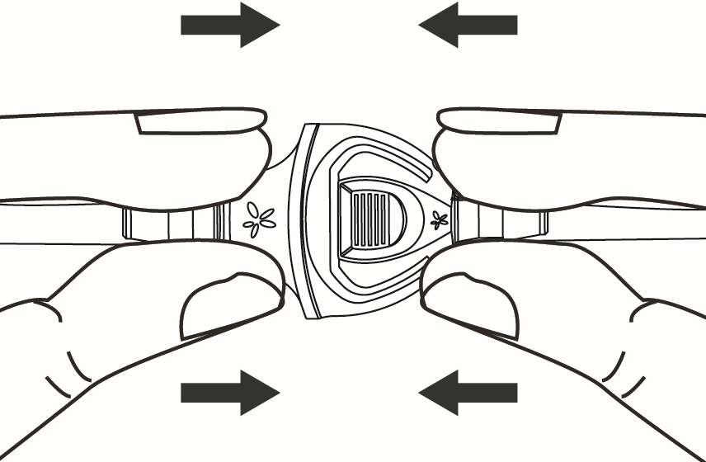
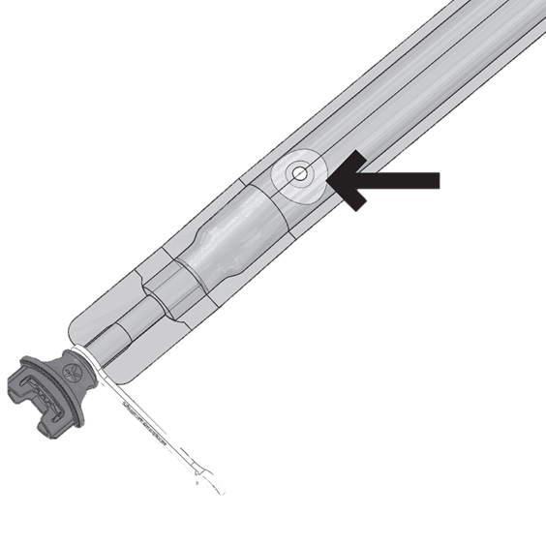
Canisters
Connect RENASYS™ Soft Port dressing and canister
Module 3a
Module 3c
Connect the dressing to the canister tubing by pushing orange quick click connectors together. An audible click indicates connection is secure.
Note: Do not cover aeration disc.

Slide 10
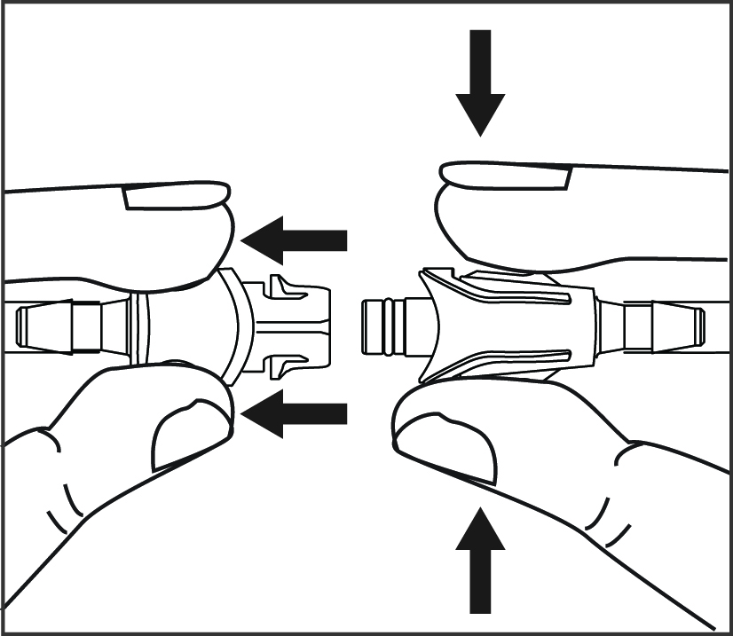
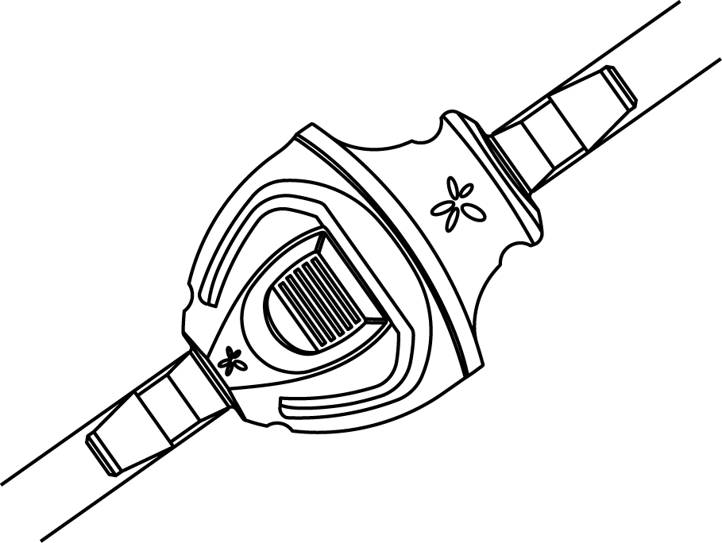
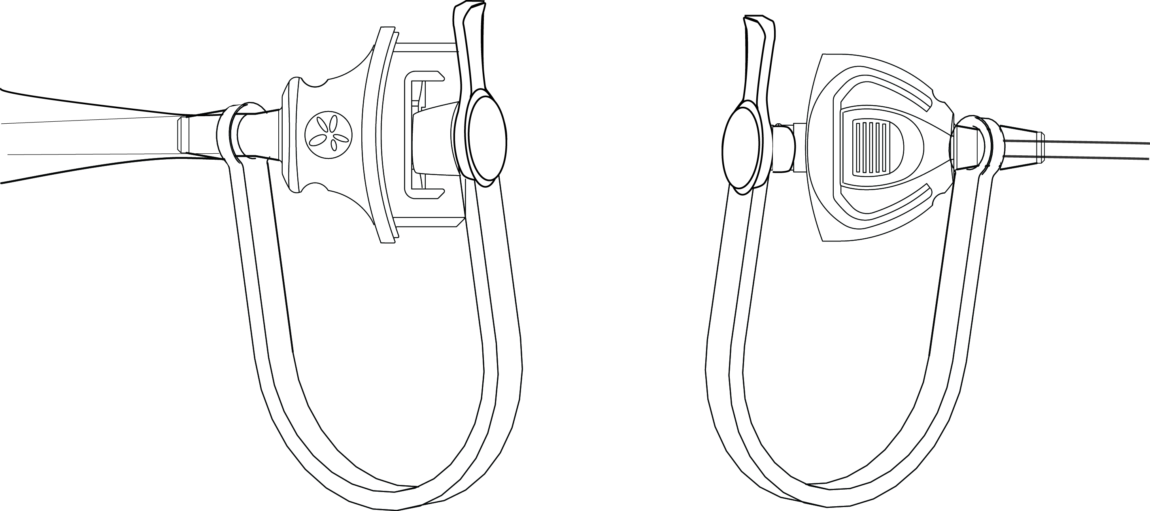
Canisters
Removing/ changing canister
Pause therapy or turn pump off.
Hold orange quick click connector above wound level to help ensure exudate does not leak from tubing.
Disconnect canister tubing from dressing tubing by applying pressure to the canister quick click connector and gently pulling connectors apart.
Close the tethered cap of both quick click connectors to protect both sides of tubing and prevent leakage.
Release canister clips on both sides of device and gently pull canister away from device.
Disposal of used canisters should follow facility protocols or local ordinances relating to handling of potential infected or bio-hazardous materials.
Module 3c

Slide 11
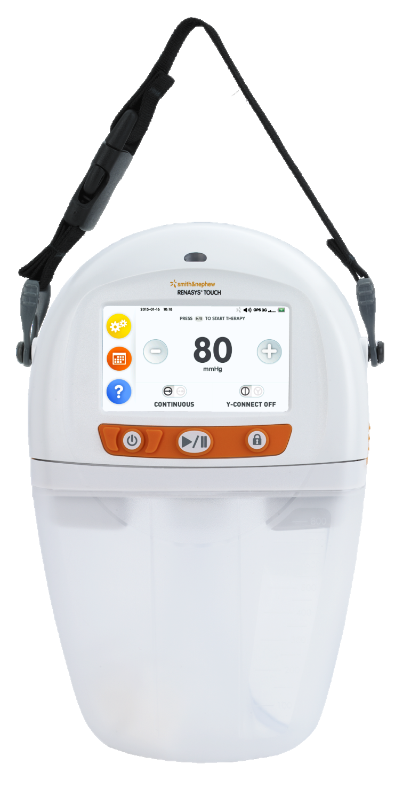
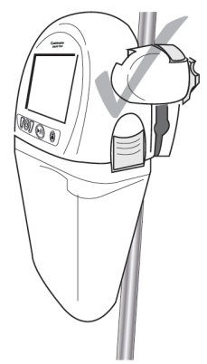

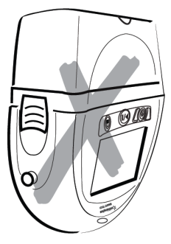
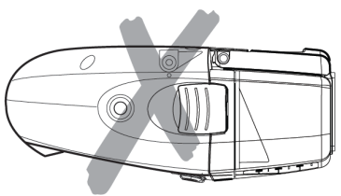
Device orientation
During use
The device is designed to operate in an upright position. Operation in the upright position optimises canister volume and alarm functionality.
Correct orientation:
Incorrect orientation:
Operating the device in a face-down position could result in damage to the device and inadvertent changes to therapy settings. Operating the device in a inverted position could impact filter occlusion resulting in a blockage alarm and requiring a change of canister.
Module 3c
300ml canisters only
300ml canisters only
300ml or 800ml canisters with carry strap or clamp
300ml or 800ml canisters

Slide 12
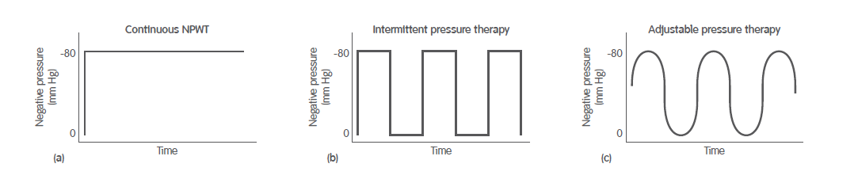
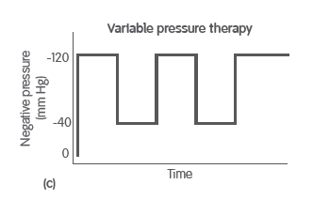
Functionality
Operating modes
NPWT can be delivered to the wound bed through:
Continuous - Pressure is applied constantly
Intermittent - Pressure is repeatedly switched on and off alternating between 0 and set pressure
Adjustable intermittent - Pressure is varied between two levels (set and low pressure)
Module 3c
Intermittent settings can be adjusted within the following ranges: High Therapy 25, 40, 50, 60, 70, 80, 90, 100, 120, 140, 160, 180, 200mmHg High Cycle times: 3, 5, 8, 10 minutes
Low Therapy 0, 25,40, 50, 60, 70, 80, 90, 100, 120, 140, 160, 180mmHg Low Cycle times: 2, 3, 5, 8, 10 minutes

Slide 13

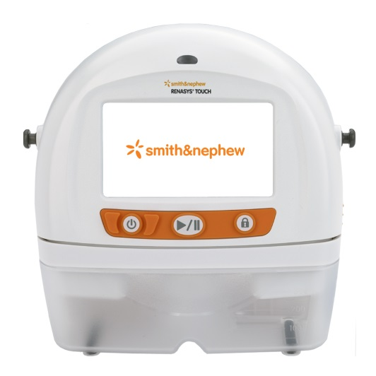

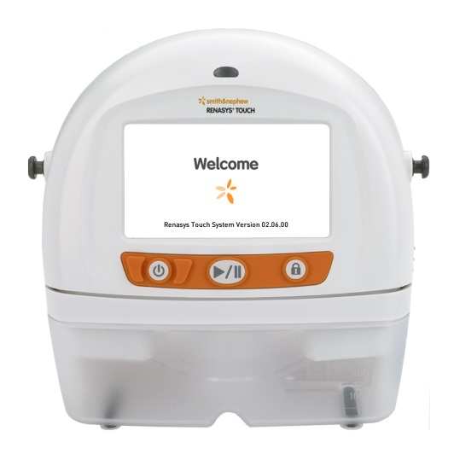
Functionality
Switching the pump on
Press and hold the Power button for 2 seconds to power On (or power Off) the pump
The touchscreen will illuminate and initiate the step start up sequence.
3. Audible alarm sounds
4. Welcome screen
2. Status indicator flashes yellow then green
5
1. Smith & Nephew screen
Home screen displays upon completion
Module 3c
Power

Slide 14
Functionality
Navigating the touchscreen interface
Date & time indicators
Therapy set point
Alarm volume indicator
Settings
Battery indicator
Log
Increase value
Module 3c
Decrease value
Help
Therapy mode toggle
Y-Connect toggle
The screen on the RENASYS™ TOUCH device is touch sensitive.
Tap the touchscreen to make a selection. Slide your finger up, down or across the screen to scroll.
Note: The touchscreen should only be actuated by finger. Using pens or other pointed objects may damage the screen.

Slide 15
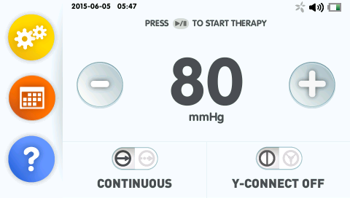
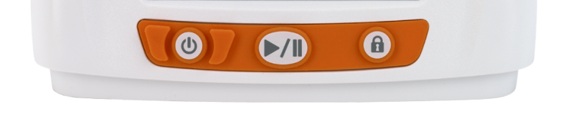
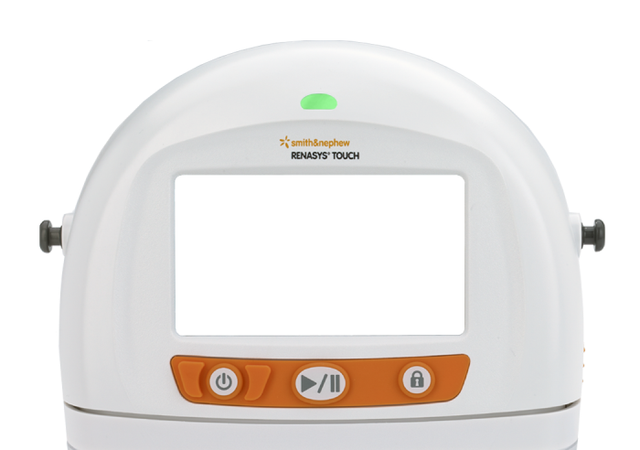
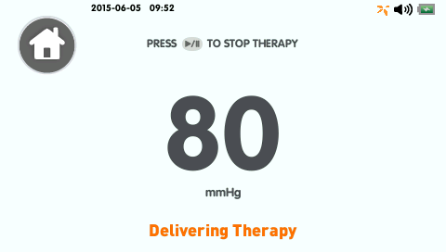
Functionality
Setting therapy – Continuous therapy mode
Step 1: Ensure that the device is powered on and use the therapy mode toggle to select continuous therapy
Step 2: Use the + or – buttons to select prescribed pressure setting
Step 3: Press the Start/Pause button to start delivering therapy
When therapy is active the status indicator on top of the device illuminates green and the therapy indicator at the top of the screen will rotate orange.
As the pump begins delivering therapy, it will perform a leak check to determine if the system is sealed or if there is a significant leak in the system
Increase value
Decrease value
Therapy mode toggle
Module 3c
Start/Pause Therapy
Therapy Indicator
Status Indicator

Slide 16
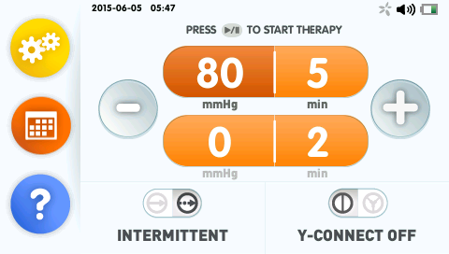
Functionality
Intermittent therapy mode
Decrease value
Increase value
Step 1: Ensure that the device is powered on and use the therapy mode toggle to select intermittent therapy
Step 2: Use the high and low therapy settings and cycle times by selecting the setting and then + or – to adjust to the prescribed pressure/time
Step 3: Press the Start/Pause button to start delivering therapy
When therapy is active the status indicator on top of the device illuminates green and the therapy indicator at the top of the screen will rotate orange.
As the pump begins delivering therapy, it will perform a leak check to determine if the system is sealed or if there is a significant leak in the system
Module 3c
Therapy mode toggle
Start/Pause Therapy
Note – Therapy must be paused to change cycle times

Slide 17
Functionality
Intermittent therapy
Intermittent therapy is not recommended for:
Highly exuding wounds
Wounds with tunnels or undermining
Wounds in difficult areas where maintaining a seal is problematic
Patients who experience pain during intermittent therapy
Module 3c

Slide 18
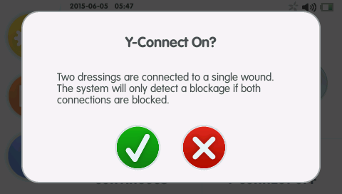
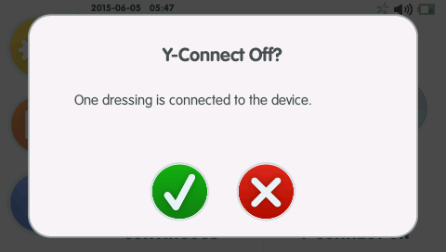
Functionality
Setting the Y-Connect
Select Y-Connect ON to adjust the blockage alarm for the controlled leak paths (CLPs) of two dressings to a single wound.
Select Y-Connect OFF if only one dressing is connected to the device.
Press the Y-Connect toggle icon to switch and press Accept to confirm selection.
Therapy must be paused to change Y-Connect setting. Feature not available in patient mode.
Module 3c
Caution - The system will only detect a blockage if both connections are blocked. Therapy will not be delivered through the blocked dressing.
Setting Y-Connect ON when only one dressing is connected to the device may cause nuisance alarms.
Setting Y-Connect OFF when two dressings are connected to the device may prevent the blockage alarm from sounding.

Slide 19
Functionality
Pause therapy
Therapy must be paused to change the following therapy settings and features:
Therapy mode
Y-Connect setting
Intermittent therapy cycle times
Compression rate
Restore presets
Module 3c

Slide 20
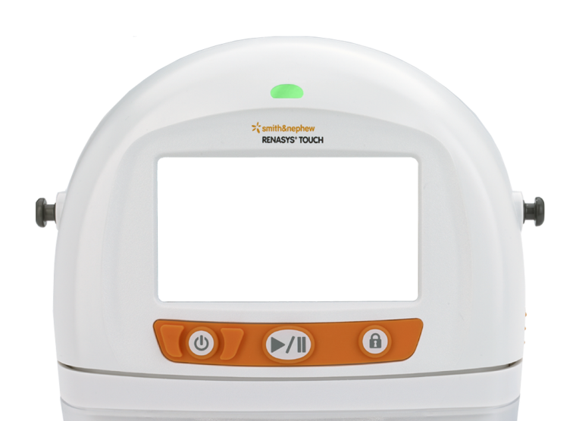
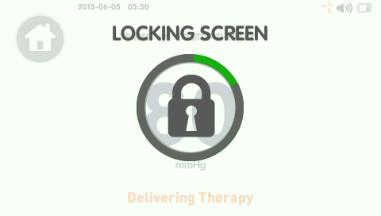
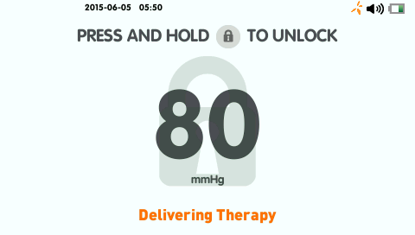
Functionality
Lock/Unlock feature
Press and hold the Lock/Unlock button for 2 seconds.
Therapy must be active to Lock.
1. Press and hold Lock button
2. Lock symbol on screen
3. Sleep mode
Lock button
Status indicator
Module 3c
The Lock function locks the touchscreen and Start/Pause Therapy icon – Power icon is not locked.
The status indicator continues to illuminate green to indicate the device is still delivering therapy.
In the event of an alarm, the device will automatically unlock and the alarm screen will display.
The device will automatically lock and enter Sleep mode after 5 minutes without user interaction when therapy is active.

Slide 21

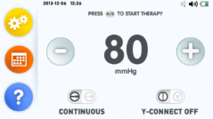
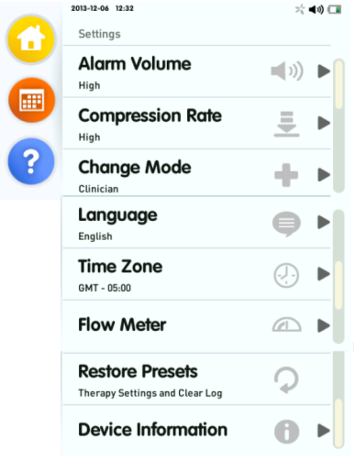
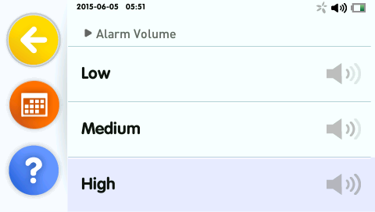
Setting
Alarm volume
Alarm volume can be adjusted to: Low (60dB), Medium (68dB)
and High (74dB) 1 metre from device.
The device will issue a sample tone as you make your selection. The Alarm Volume indicator on the Settings menu and at the top of the screen will update based on the selection.
Alarm Volume indicator
Module 3c

Slide 22
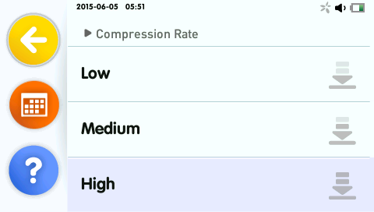
Settings
Compression rate
The compression rate limits the target pressure change in a given period of time to a maximum amount. Selecting the high compression rate will result in the most rapid dressing draw down.
Select the Compression Rate indicator on the Settings menu to update based on the selection.
Note - Therapy must be paused to change Compression Rate
Module 3c

Slide 23
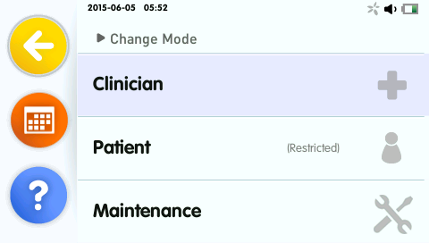
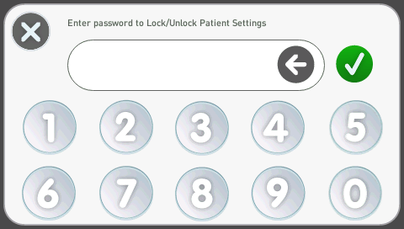
Settings
Change of mode
The device has three user modes: Clinician, Patient and Maintenance.
A password is required to switch between modes.
The password for Clinician and Patient modes (3141) is provided in the Clinician User Manual.
The password for Maintenance mode is provided in the Service Manual.
Module 3c

Slide 24
Settings
Modes for clinician and patient
Clinician Mode provides healthcare providers full access to features and settings.
Patient Mode prevents inadvertent changes to therapy settings by restricting access to therapy settings and certain settings menu selections.
All settings available
Restricted settings
Module 3c

Slide 25
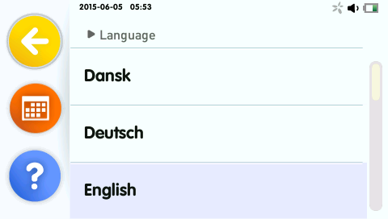
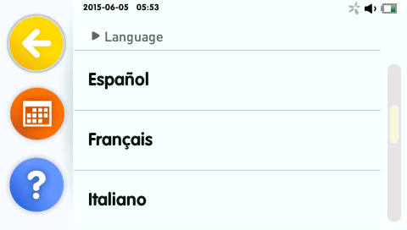
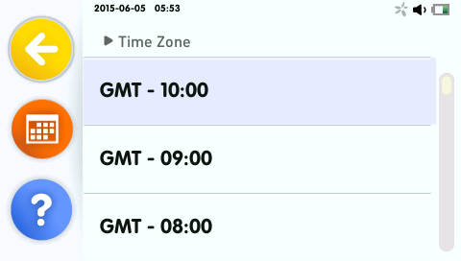
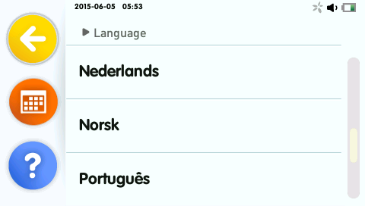
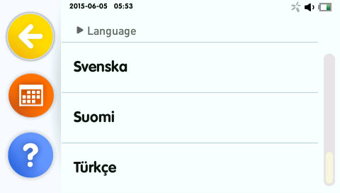
Settings
Language and time zone
The device is available in 12 languages and time zone is available for selection.
Select language/ time zone from the Settings menu.
Module 3c

Slide 26
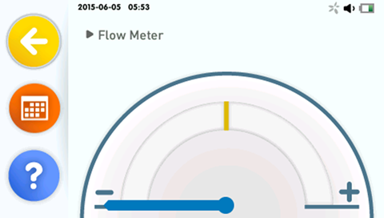
Settings
Flow meter
The Flow Meter provides a visual indication of the rate of air flow in the system to help determine if the system is properly sealed or if there are leaks. The gauge will turn yellow if a significant leak is detected.
Select Flow Meter from the Settings menu.
In the event of a leak alarm, the Flow Meter is displayed on the screen to assist in locating leaks in the system.
Module 3c

Slide 27

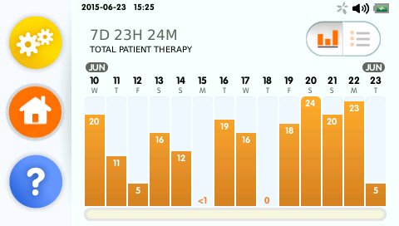
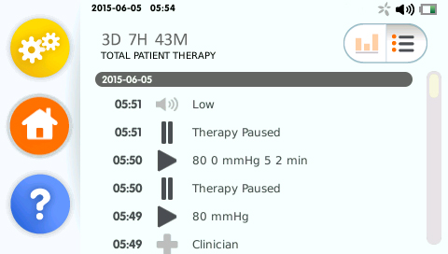
Settings
Therapy log
The Therapy Log displays Total Pump Activity (accumulated active therapy days, hours and minutes) since last Restore Presets and provides information on therapy that has been delivered by the pump in two display formats.
Select the Log toggle icon to switch between Overview and Detailed view.
Total Pump Activity
Log toggle
Module 3c
Overview
Bar graph of total therapy hours per day.
Detailed view
Events history: therapy settings, alarms and device status.

Slide 28
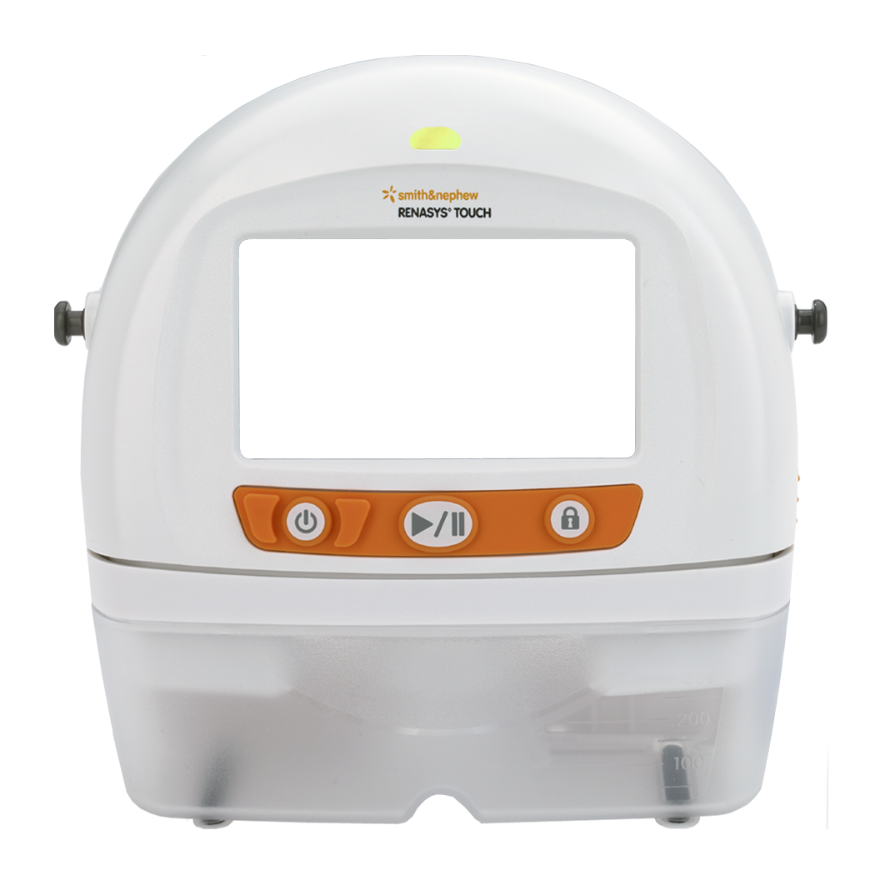
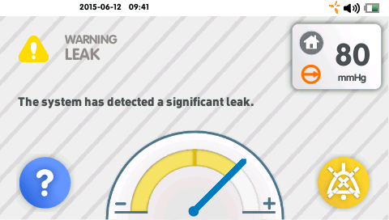
Alarms
Device overview
In the event of an alarm, an audible tone sounds, an alarm screen will display and the status indicator illuminates yellow.
Alarm description
Status indicator
Home
(press to navigate to Home screen)
Alarm indicator
Module 3c
Therapy
set point
Alarm information
Therapy
mode
Help
(troubleshooting information)
Flow Meter
(displays during leak alarm)
Pause Alarm
(grey when paused)

Slide 29
Alarms
Cautions
All RENASYS™ TOUCH alarms are determined to be ‘Low Priority’ and require user awareness.
The device stops delivering therapy in the occurrence of an Over Vacuum, High Vacuum, unattended Critical Battery, unattended Battery Failed or Device Failed alarm.
Caution : Alarms are not intended to replace physical inspection and monitoring of the system. The patient, pump and wound dressing should be monitored regularly to ensure therapy is being delivered.
Some alarms allow the audible alarm to be paused for approx. 2 minutes.
When multiple alarms states are present, the pump will alternate between alarm screens every 5 seconds.
Module 3c

Slide 30
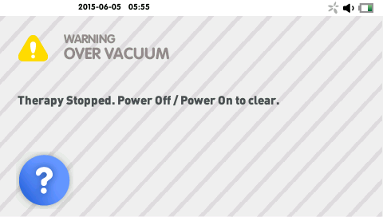
Alarms
Over vacuum alarm
Symptoms | Cause | Remedy
Over vacuum alarm Device stops delivering therapy. Status indicator illuminates yellow. Audible alarm sounds every 20 seconds. Audible alarm cannot be paused. | The system has detected an excessively high vacuum (>235mmHg), potentially due to device malfunction. | Power off and restart the device If the alarm recurs there is a potential malfunction of the device. Contact your Smith& Nephew authorised representative
Module 3c

Slide 31
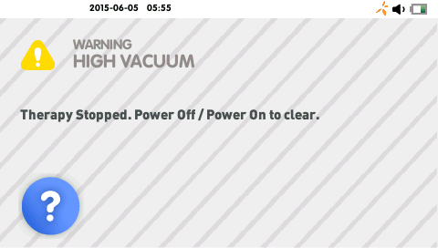
Alarms
High vacuum alarm
Symptoms | Cause | Remedy
High vacuum alarm Device stops delivering therapy. Status indicator illuminates yellow. Audible alarm sounds every 20 seconds. Audible alarm cannot be paused. | The system has detected a high vacuum (>15mmHg above the therapy set point), potentially due to device malfunction. | Power off and restart the device If the alarm recurs there is a potential malfunction of the device. Contact your Smith& Nephew authorized representative
Module 3c

Slide 32
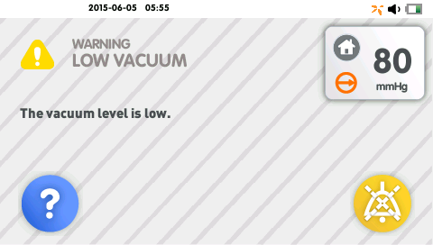
Alarms
Low vacuum alarm
Symptoms | Cause | Remedy
Low vacuum alarm The device continues to operate but may not provide prescribed therapy. Status indicator illuminates yellow. Audible alarm sounds every 20 seconds. Audible alarm may be paused for approx. 2 minutes by pressing the Pause Alarm icon on the screen. | The vacuum level is lower than the therapy set point by >15mmHg for longer than 60 seconds. | Do not pause therapy or power Off the device while performing the following steps. Assess the device after each step. Continue to next step only if alarm remains unresolved. Check the wound dressing for air leaks. Look for loose or decompressed dressing appearance, listen for air movement around the dressing and feel for areas less compressed or cooler in temperature. Address any identified leaks with transparent film or adhesive gel patches. Ensure all connections are secure. Dressings and canister tubing quick click connectors. Y-connector quick click connectors, if applicable. Disconnect the canister from the dressing tubing by applying pressure to the canister tubing quick click connector and gently pulling the connectors apart. Close the tethered caps of both connectors. If the alarm continues, a leak exists within the canister or at the canister to device connection. Replace the canister. Refer to "Removing/changing canister" section of manual for more details. Contact your Smith & Nephew authorized representative if the alarm continues after restarting therapy. If the alarm resolves, a leak exists within the wound dressing or tubing. Reassess and replace as needed. Note: If Low Vacuum alarm is due to a leak in system, the Leak alarm may also be triggered while the Low Vacuum alarm is active.
Module 3c

Slide 33
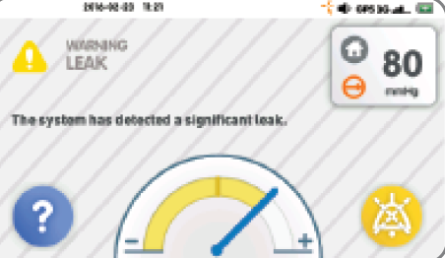
Alarms
Leak alarm
Symptoms | Cause | Remedy
Leak alarm The device continues to operate but may not provide prescribed therapy. Status indicator illuminates yellow. Audible alarm sounds every 20 seconds. Audible alarm may be paused for approx. 2 minutes by pressing the Pause Alarm icon on the screen. | The system leak is greater than the allowable maximum leak threshold for >45 seconds. | Do not pause therapy or power Off the device while performing the following steps. Use the on-screen flow meter to help find out and correct source of the leak. Assess the device after each step. Continue to next step only if alarm remains unresolved. Check the wound dressing for air leaks. Look for loose or decompressed dressing appearance, listen for air movement around the dressing and feel for areas less compressed or cooler in temperature. Address any identified leaks with transparent film or adhesive gel patches. Ensure all connections are secure. Dressings and canister tubing quick click connectors. Y-connector quick click connectors, if applicable. Disconnect the canister from the dressing tubing by applying pressure to the canister tubing quick click connector and gently pulling the connectors apart. Close the tethered caps of both connectors. If the alarm continues, a leak exists within the canister or at the canister to device connection. Replace the canister. Refer to "Removing/changing canister" section of manual for more details. Contact your Smith & Nephew authorized representative if the alarm continues after restarting therapy. If the alarm resolves, a leak exists within the wound dressing or tubing. Reassess and replace as needed.
Module 3c

Slide 34
Alarms
Leak – lack of alarms
Caution – lack of alarms: When a significant air leak is present in system, the Leak alarm will assert. However, if a blockage is present within system it may prohibit detection of a significant leak by the device, resulting in no alarm assertion. Potential sources of a blockage include:
Physical occlusion in wound dressing (clot in filler, compacted gauze, high volume viscous fluid).
Physical occlusion in tubing (kink in canister tubing, clot in tubing).
Misaligned dressing opening to RENASYS™ Soft Port aperture.
Check dressing regularly to ensure therapy is being delivered.
Module 3c

Slide 35
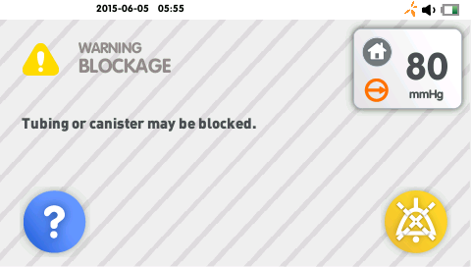
Alarms
Blockage
Symptoms | Cause | Remedy
Blockage alarm The device continues to operate but may not provide prescribed therapy. Status indicator illuminates yellow. Audible alarm sounds every 20 seconds. Audible alarm may be paused for approx. 2 minutes by pressing the Pause Alarm icon on the screen. | The system has detected a blockage within the canister, or the tubing or the internal canister filter is covered with exudate, which may occur even if canister does not appear visibly full. | Do not pause therapy or power Off the device while performing the following steps. Assess the device after each step. Continue to next step only if alarm remains unresolved. If one dressing is connected to the device, press the Home icon to navigate to the Home screen and ensure that the Y-Connect toggle icon is set to Y-Connect OFF . Ensure all tubing and connections are free of any obstructions or kinks. Disconnect the canister tubing from the dressing tubing by applying pressure to the canister quick click connector and gently pulling the connectors apart. Leave open the tethered cap of the canister quick click connector and close the tethered cap of the dressing connector. If the alarm continues, the blockage exists within the canister. Replace the canister. Refer to "Removing/changing canister" section of manual for more details. Contact your Smith & Nephew authorized representative if the alarm continues after restarting therapy. If the alarm resolves, the blockage exists within tubing of the dressing. Reassess and replace as needed. Note: Device orientation, rate at which fluid enters the canister and how exudate solidifies can impact filter occlusion. To optimize canister volume and alarm functionality, keep the device in the upright position.
Module 3c

Slide 36
Alarms
Lack of blockage alarms - caution
A Y-connector should be used when applying two dressings to a single wound. Setting Y-Connect On when only one dressing is connected to the device may cause nuisance alarms. Setting Y-Connect Off when two dressings are connected to the device may prevent blockage alarm from sounding. When Y-connecting two dressings to the device, regular monitoring of the wound is recommended. Ensure the dressing is fully compressed and firm to the touch. The system will only detect a blockage if both connections are blocked. The system will not detect a blockage existing in one of the Y-connected dressings; therapy will not be delivered through the blocked dressing.
The blockage alarm will occur when the system detects a blockage between the canister and where the dressing tubing interfaces with the transparent film. A blockage within the wound dressing will not be detected by the system.
If a blockage is present in the system but an air leak occurs between the blockage and the device, the alarm may not assert. Ensure that all connections are secure and there are no air leaks present in the system. Potential sources of air leaks include:
Cracked or damaged canister.
Misplaced or worn o-ring within the quick click connector.
Misplaced or worn o-ring on the device inlet port.
Damage or tear in the dressing tubing or quick click connector.
Module 3c

Slide 37
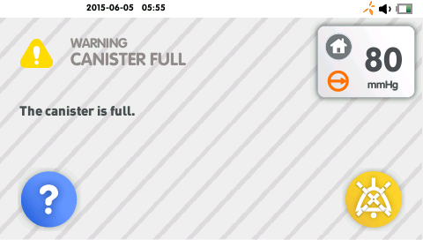
Alarms
Canister full
Symptoms | Cause | Remedy
Canister full alarm The device continues to operate but may not provide prescribed therapy. Status indicator illuminates yellow. Audible alarm sounds every 20 seconds. Audible alarm may be paused for approx. 2 minutes by pressing the Pause Alarm icon on the screen. | The system has detected the canister is nearly full or the internal canister filter is covered with exudate, which may occur even if canister does not appear visibly full. | Pause therapy before performing the following troubleshooting steps. Assess the device after each step. Continue to the next step only if the alarm remains unresolved. Replace canister and start therapy. Refer to "Removing/changing canister" section of manual for more details. Inspect all tubing and connections for any obstructions or kinks. If alarm continues, contact your Smith & Nephew authorized representative for assistance. Note: Device orientation, rate at which fluid enters the canister and how exudate solidifies can impact filter occlusion. To optimize canister volume and alarm functionality, keep the device in the upright position.
Module 3c

Slide 38

Alarms
Low battery
Symptoms | Cause | Remedy
Low battery alarm Upon battery depletion the device will stop delivering therapy and power Off. Status indicator illuminates yellow. Audible alarm sounds every 20 seconds. Audible alarm may be paused for approx. 2 minutes by pressing the Pause Alarm icon on the screen. The touchscreen dims to conserve battery life. | The battery has up to 2 hours therapy time remaining. | Plug device into an electrical (AC) outlet as soon as possible. The device can be plugged into an electrical (AC) outlet to charge the battery without causing interruption to active therapy.
Module 3c

Slide 39


Alarms
Critical battery
Symptoms | Cause | Remedy
Critical battery alarm Upon battery depletion the device will stop delivering therapy and power Off. Status indicator illuminates yellow. Audible alarm sounds every 20 seconds. Audible alarm may be paused for approx. 2 minutes by pressing the Pause Alarm icon on the screen. The touchscreen dims to conserve battery life. | The battery has only 3 minutes of therapy time remaining | Plug device into an electrical (AC) outlet as soon as possible. The device can be plugged into an electrical (AC) outlet to charge the battery without causing interruption to active therapy.
Module 3c

Slide 40

Alarms
Battery failed
Symptoms | Cause | Remedy
Battery failed alarm Device stops delivering therapy and powers off. It will not power On again unless plugged into an electrical (AC) outlet. Status indicator illuminates yellow when the pump is powered on. There is no audible alarm Note: Battery Failure alarm only displays when device is connected to electrical (AC) and powered on | The battery within the device has failed to charge. Therapy can be continued only by keeping the device plugged into electrical (AC) power. | If the device has been exposed to temperatures outside its recommended temperature range, let the device return to room temperature. Plug device into an electrical (AC) outlet; the device will not operate on battery power. Contact your Smith & Nephew authorized representative to obtain a replacement device.
Module 3c

Slide 41

Alarms
Device failed
Symptoms | Cause | Remedy
Device failed alarm Device stops delivering therapy. Status indicator illuminates yellow. Audible alarm sounds every 20 seconds. Audible alarm cannot be paused. | The device has an unrecoverable error, potentially due to an internal hardware or software error. | Power off and restart the device If alarm recurs note the failure code and contact your Smith & Nephew authorized representative.
Module 3c

Slide 42

Alarms
Inactive
Symptoms | Cause | Remedy
Inactive alarm Device continues to operate. Status indicator illuminates yellow. Audible alarm sounds every 20 seconds. | The device is powered on and has been left without user interaction for longer than 15 minutes. | Touch anywhere on the screen to resolve alarm. Select vacuum setting and start therapy or power Off device until therapy is required.
Module 3c

Slide 43

RENASYS™ TOUCH accessories
IV pole/ bed clamp
The device can be attached to an IV pole or the head or foot of the patient’s bed.
Place device in clamp
The clamp comes equipped with a holder for the carry straps. To utilise remove carry straps from device and attach them to the carry strap holder on side of clamp (optional).
Align device attachment knobs with clamp attachment recesses.
Push device gently into clamp attachment recesses. The clamp’s orange clips will open during installation.
Press down on the orange clamp clips to close.
Remove device from clamp
Lift orange clamp clips.
Gently pull device from clamp attachment recesses.
Attach clamp to IV pole (up to 51mm/2in diameter | Attach clamp to bed board (up to 76mm/3in diameter
Twist knob to open clamp Align IV pole in centre groove of clamp pad Twist knob to close clamp until firmly seated | Twist knob to open clamp Place clamp over bed board Twist knob to close clamp until firmly seated
Module 3c

Slide 44

RENASYS™ TOUCH accessories
Carry bag
The carry bag is single patient use
To place device into bag:
Open zippers on the back side of the bag.
Remove carry straps from the device. Keeping the device in the upright position, slide bag over and down the device. Ensure attachment knobs are accessible through the bag on either side.
Close zippers and reattach carry straps.
Once fitted, ensure canister tubing can move freely.
Caution - Ensure the device always remains
in the upright position. Note - It is recommended to lock the device
when using the carry bag.
Card or contact information pocket under display flap.
Privacy flaps provide access to the touchscreen and canister window.
Module 3c
Excess tubing can be coiled into the pocket on the back of the bag.
Charging the device while in the carry bag may result in elevated operating temperature, causing the device to suspend charging until it cools. The device continues to operate. To reduce the operating temperature of the pump, remove it from the carry bag or move it into an environment with a lower ambient temperature. When the device cools, charging will resume automatically.
Notes:
Device heating in bag – stops charging
Carry bag
The carry bag is single patient use.
To place device into bag:
Open zippers on the back side of the bag.
Remove carry straps from the device. Keeping the device in the upright position, slide bag over and down the device. Ensure attachment knobs are accessible through the bag on either side and reattach carry straps.
Close zippers.
Once fitted, ensure canister tubing can move freely.
Note: it is recommended to Lock the device when using the carry bag
Caution: Ensure the device always remains in the upright position when placing the device in and while using the carry bag
Bag features:
Excess tubing can be fed through either the tubing hole under the pocket or through the bottom of the bag and coiled into the pocket on back of the bag.
Flaps on the front of the bag are for the privacy of the user and can be lifted to access the touchscreen or view the canister.
The card pocket under the front flap can hold a business card or contact information.
A belt loop is located on the rear of the bag should you wish to wear the RENASYS™ TOUCH at your waist.

Slide 45





RENASYS™ TOUCH accessories
Carry strap
The carry strap is single patient use
To attach the carry strap to the device :
Slide the large opening of the carry strap clip over the device attachment knob.
Pull up on the carry strap clip. The clip will click when properly engaged. Repeat same process with other strap on opposite side of device.
Once both sides are connected to the device they can be joined together to make the short carry strap.
Push down on the carry strap clip to remove strap from device.
To connect and extend straps:
Join the carry strap connectors together for a short carry strap.
Join the carry strap connectors to the shoulder strap and/or extension strap connectors to extend the length for carrying on the shoulder or across the body.
Place the padded section of the strap against shoulder for maximum comfort when carrying device.
Ensure the device always remains in the upright position when using the carry bag and straps.
Module 3c
Notes:
Carry straps
The carry straps are single patient use.
To attach the carry strap to device:
Slide the large opening of the carry strap clip over the device attachment knob.
Pull up on the carry strap clip. The clip will click when properly engaged. Repeat same process with other strap on opposite side of device.
Once both sides are connected to the device they can be joined together to make the short carry strap.
Push down on the carry strap clip to remove strap from device.
Caution: Ensure the device always remains in the upright position when using the carry straps.
To connect and extend straps:
Join the carry strap connectors together for a short carry strap.
Join the carry strap connectors to the shoulder strap and/or extension strap connectors to extend the length for carrying on the shoulder or across the body.
Place the padded section of the strap against shoulder for maximum comfort when carrying device.

Slide 46
Maintenance and service
Maintenance
Inspect the pump for visible signs of damage before each use, including canister and tubing. Do not use if device has been dropped or shows signs of damage. Return damaged device to your Smith & Nephew authorised representative in the original packaging supplied.
Visually inspect the device inlet port O-ring for damage – this should be replaced at a minimum once per year as part of the annual maintenance check.
As there are no serviceable parts in the device, do not attempt to open device housing. Contact your Smith & Nephew representative, distributor or authorised provider if service is required.
Caution - Never attempt to service the device while connected to a patient.
Module 3a
Module 3c

Slide 47
Maintenance and service
Cleaning
Cleaning of RENASYS™ TOUCH device, power supply outer casing and IV pole/bed clamp should be performed to remove any soil or debris whenever there is a change in patient.
Turn off the device and disconnect from AC power before cleaning and disinfecting to prevent electrical shock.
Wipe down surface with a dampened cloth or disposable wipe. A neutral pH7 based detergent, detergent/disinfectant or antimicrobial agent that is safe for use with plastics may be used.
Visually inspect surface for debris or soils that have not been removed and repeat cleaning steps if necessary.
Do not use solvents or abrasives that will degrade plastic housing, rubberized push buttons or touchscreen.
Do not immerse/submerge any part of device in fluid or use an excessively wet cloth. No fluids should enter device. If any liquids penetrate device contact your Smith & Nephew distributor or authorised provider.
Carry bag and carry straps are designed for single patient use.
Module 3c
Refer to RENASYS™ TOUCH Clinician manual for more information regarding disinfecting the device.

Slide 48
Maintenance and service
Battery operation
To allow user greater mobility, the device contains a lithium ion rechargeable battery that requires a full charge before initial use.
Fully charged battery lasts between 8 to 16 hours.
To charge battery
Connect the power supply DC cord into the device power jack.
Connect the power cord into the power supply.
Plug the power cord into an electrical (AC) outlet.
Verify green external power indicator illuminates.
Caution – Keep device away from direct heat sources during charging.
Caution - Charging the device while in the carry bag may result in elevated operating temperature that causes the device to suspend charging until it cools. The device continues to operate. To reduce the operating temperature, remove from carry bag or move to lower temperature environment. When the device cools, charging will resume automatically.
Caution - Care should be taken to ensure the power supply used for charging is not covered by blankets or clothing to avoid a fire hazard.
Module 3c

Slide 49
Maintenance and service
Storage and transit case
Storage:
The device should be stored between 5 to 40°C for optimal battery performance but can be stored between -25 to 70°C for short periods of time. Some battery discharge may occur in storage.
If the device is stored for longer than 6 months, the battery should be fully charged before use.
If the device indicates that the battery is still charging after more than 8 hours of continuous charge, contact your Smith & Nephew distributor or authorised provider.
Caution – If the device has been stored at temperatures below freezing, it must be brought to room temperature prior to use or the device may be damaged.
A transit case for RENASYS™ TOUCH is available.
Module 3c

Slide 50


Annual maintenance
When the device is nearing time for the annual maintenance check, an annual maintenance notification will display every time the device in powered On.
Notify your authorised service provider that the annual maintenance is required. Authorised service providers can verify the pump is in proper working order and reset the alarm timer.
Module 3c
Refer to ‘Annual Maintenance’ under ‘Alarms/ Troubleshooting’ section for details on the notification.

Slide 51
RENASYS™ TOUCH devices
Specific warnings and precautions
A Y-Connector should be only be used when applying two dressings to a single wound. The system will only detect a blockage if both connections are blocked.
For patients with high risk of bleeding use 300ml canister. Ensure the 300ml canister viewing window is checked frequently for signs of bleeding.
RENASYS TOUCH pumps are only to be used with Smith & Nephew authorised components. Use of any other products have not been proven safe and effective with RENASYS TOUCH.
Ensure canister tubing and RENASYS Soft Port are installed completely and without any kinks to avoid leaks or blockages in vacuum circuit. Position the pump and tubing appropriately to avoid risk of a trip hazard. Pump and system tubing should be positioned no more than 19in/ 50cm higher than the wound to ensure optimization of therapy and prevent therapy interruption.
Canisters should be changed at least once a week, whenever there is a change in patient or in the event the canister contents reach maximum volume indication (300ml or 800ml fill line). Do not wait for canister over-capacity alarm activation to change canister.
Due to its smaller diameter, the RENASY-G 10Fr Round Drain Gauze kit and Accessory kit are not recommended for use with RENASYS TOUCH as reduced pressure in the wound bed may lead to pooling or maceration.
Module 3c
Refer to Clinician manual for full list of warnings and precautions when using RENASYS TOUCH.

Slide 52
RENASYS™ TOUCH
Ordering information
Product description | Product code
RENASYS TOUCH Pump Power cord | 66801280
RENASYS TOUCH IV POLE/Bed clamp | 66801278
RENASYS TOUCH Carry Bag and Strap | Carry straps 66801276 Carry bag 66801277
Product description | Product code
RENASYS 300ml Canister 5 kits per case Sealed canister Overflow guard with silicone tubing Solidifier Canister tubing RENASYS 800ml Canister 5 kits per case Sealed canister Overflow guard with silicone tubing Solidifier Canister tubing | 300ml with solidifier: 66801273
 | 800ml with solidifier: 66801274
Module 3c

Slide 53
RENASYS™ TOUCH
Product quiz
1. What vacuum range is RENASYS TOUCH able to operate at?
-25mmHg to -200mmHg
2. What is the password for switching between clinician and patient mode?
3141
When will the flow meter appear on screen?
  In the event of a leak alarm the flow meter will be displayed on screen to assist in locating leaks in the system
4. What does the therapy log provide?
Displays the Total Pump Activity (accumulated active therapy days, hours and minutes)
since last Restore pre-sets and provides information on therapy that has been delivered in 2 formats – overview in graphical form or detailed view in log of events
What are the 3 operating modes of RENASYS TOUCH?
Continuous, intermittent and adjustable intermittent
6. When can you call Smith & Nephew for support?
24/7 support is available via phone Australia: 13 13 60 / New Zealand: 0800 807 663
Module 3c

Slide 54
RENASYS™ TOUCH
Demonstration
Install the RENASYS TOUCH canister
Turn on the device to continuous mode and select pressure setting -120mmHg
Change the therapy mode from continuous to intermittent
Change the therapy mode from continuous to adjustable intermittent
Demonstrate how to switch the pump from patient to clinician mode
Demonstrate how to access the troubleshooting section
Module 3c

Slide 55
References
Forlee M, et al. An interim analysis of device functionality and usability of RENASYS TOUCH – a new portable Negative Pressure Wound Therapy (NPWT) system. Poster presented at WUWHS Conference, Florence; 2016.
Module 3c

Slide 56
For detailed product information, including indications for use, contraindications, effects, precautions, warnings, and important safety information, please consult product’s Instructions for Use (IFU) prior to use.
™Trademark of Smith & Nephew. SN13722 (03/18)

