Slide 1
Reducing the burden of pressure injuries
Helping to get you CLOSER TO ZERO™ pressure injury incidence

Slide 2





Pressure injury incidence rates still remain high despite implementation of prevention protocols¹
Less than half of “at risk” patients receive adequate preventive measures with their hospital treatment as recommended in guidelines¹
  Pressure injury (PI) incidence rates of 15% or higher continue to be reported in at-risk patient populations¹
Orthopaedic surgical – 8.8% to 55%^{2,3,4}
PIs can arise from orthopaedic surgeries, especially hip fractures in elderly patients,
and mainly occur in the sacral area
Surgical patients – Up to 45%⁵
PIs arising from surgeries account for almost half of all hospital-acquired PI incidences
Intensive care unit (ICU) – 14 – 42%⁶
Patients in ICUs are predisposed to pressure injuries because of limited mobility and the severity of their disease
Emergency department (ED) – Up to 19%⁷
Studies suggest pressure injuries are a common complication in EDs, even for short stays,
with many patients discharged with HAPIs
Medical device related⁸
The most common devices of which pressure injuries occur are
nasal oxygen tubing 26%
cast/ splints 12%
continuous positive airway pressure/bi-level positive airway pressure masks 9%
Published international guidelines make recommendations for developing an effective pressure ulcer prevention strategy for patients at risk⁹

Slide 3

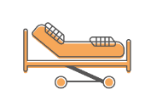




Pressure injuries cost more than just money¹⁰
Hospitalised patient
Results in
Patient pain
and discomfort¹²
Decrease in patient’s quality of life
and recovery¹²
Impact families
and care givers
Patient embarrassment and feelings of isolation¹³
Increased cost of care
of $8014*¹⁰
Increased length of stay
by 3.7 days*¹⁰
Increased number
of readmissions
between 30-180 days*¹⁰
Increased number
of litigations for pressure injuries against
healthcare institutions¹¹
Hospitals can incur penalties
or loss of payments
for hospital-acquired
complications¹⁰
* compared to patients without hospital-acquired pressure injuries

Slide 4

Prevention is better than cure
Many pressure injuries are preventable if correct measures are taken
Pressure injury prevention saves:
Healthcare providers the cost, time and resource required to treat a pressure injury
Patients the emotional and physical challenges of dealing with a wound acquired
in a clinical setting
Patient satisfaction is an increasingly significant metric for hospitals, and the development of a pressure injury whilst in the care of the hospital will negatively affect this metric

Slide 5

Many pressure injuries are preventable if correct measures are taken¹¹
Some of the most important factors to consider are:
  Having a comprehensive protocol that is clearly communicated, understood and implemented
  by staff
  Regular assessment
  and checking of the skin
  Consistent and thorough education, to ensure protocols are implemented correctly
  and assessment is thorough

Slide 6



Guidelines on the use of prophylactic foam dressings
Dressings used for pressure injury prevention should always be used alongside standard pressure injury prevention protocols¹¹
When selecting a prophylactic dressing consider:¹¹
Ability of the dressing to manage microclimate
Ease of application and removal
Ability to regularly assess the skin
Anatomical location where the dressing will
be applied
Correct dressing size
NPUAP-EPUAP-PPPIA* joint
international guidelines recommend:
“Consider applying a polyurethane foam dressing
to bony prominences (e.g. heels, sacrum) for the prevention of pressure ulcers in anatomical areas frequently subjected to friction and shear” ⁹
*NPUAP-National pressure ulcer advisory panel
EPUAP- European pressure ulcer advisory panel
PPPIA- Pan pacific pressure injury alliance

Slide 7
Indications for prophylactic use of dressings for pressure injuries¹¹
Immobility
or planned immobility
Loss of sensation that reduces
spontaneous movement
(due to surgery or nerve damage)
On scar tissue
from a previous pressure injury
Reduced or restricted mobility,
or atypical movement
Medical devices
and securements
Dressings should be used alongside standard pressure injury prevention protocols e.g. a SSKIN bundle (pressure-redistributing support surface, regular skin inspection, keep moving [repositioning], management of incontinence/moisture and optimised nutrition)

Slide 8
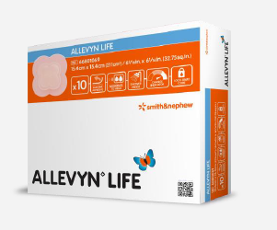
ALLEVYN™ LIFE dressings
ALLEVYN LIFE is an innovative, 5-layer dressing for wound management
and pressure injury prevention.
Can be used for pressure injury prevention on intact skin
as part of a pressure injury prevention protocol
Dressing was developed in response to patient
and clinician research highlighting concerns with:
  Leakage of wound fluid
  Strikethrough and unsightly appearance of exudate
  Wound odour
  Protection of the wound and of pressure points

Slide 9
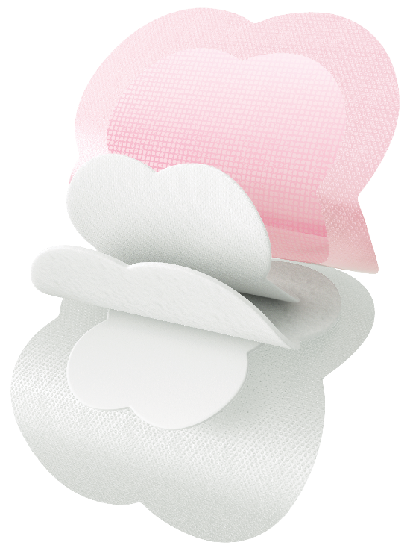

ALLEVYN™ LIFE has pressure relieving technology¹⁴
Shower-proof,
highly breathable film^{15,16}
Built-in discretion
(masking layer)^{15,17}
Highly absorbent,
lock-away core^{16,18}
Hydrocellular foam
Silicone adhesive wound
contact layer
The multi-layer construction of ALLEVYN LIFE
redistributes pressure when measured in vitro¹⁴
The results of in vitro simulation testing have not been proven to predict clinical performance

Slide 10
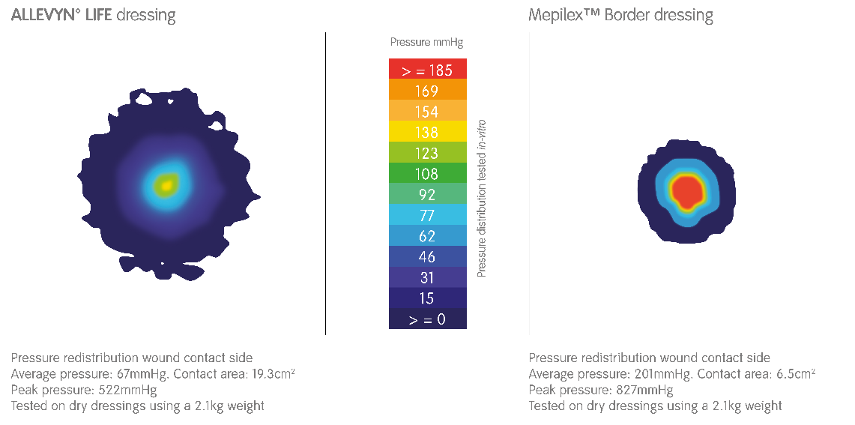
Pressure redistribution study¹⁴
Pressure contributes to pressure injury development by compressing tissues and distorting skin and soft tissues,
such as subcutaneous fat and muscle¹¹
In a pressure redistribution study, conducted in-vitro:
ALLEVYN LIFE redistributes pressure across and through the dressings¹⁴
ALLEVYN LIFE significantly reduced average pressure and peak pressure compared to other traditional dressings,
even when wet (P<0.001)¹⁴
The results of in vitro simulation testing have not been proven to predict clinical performance

Slide 11
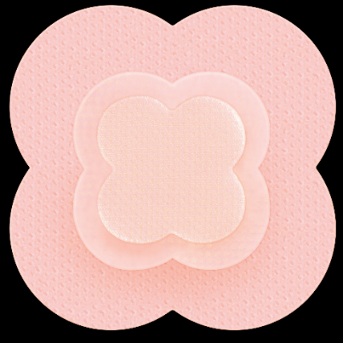
ALLEVYN™ LIFE stays in place¹⁹
In a volunteer trial:
ALLEVYN LIFE stayed in place for up to 7 days
which may reduce the frequency of dressing changes¹⁹
More ALLEVYN LIFE dressings stayed in place significantly (p<0.001) longer than MepilexTM Border:¹⁹
  Dressings were assessed for their ability to stay in place with a higher number of ALLEVYN LIFE dressings remaining in place after 3 and 7 days compared to MepilexTM Border dressings¹⁹
To help facilitate regular skin inspections,
ALLEVYN LIFE allows lifting and repositioning
without losing its adherent properties and features
a wide border and silicone-gel adhesive.^{15,20,21}

Slide 12
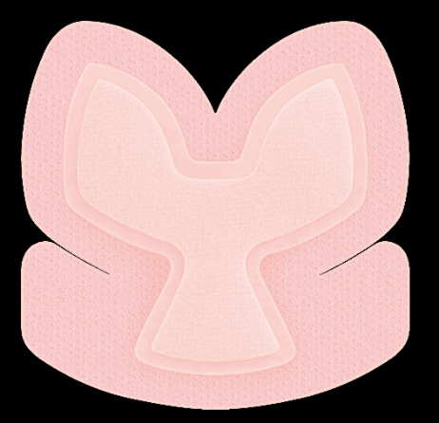
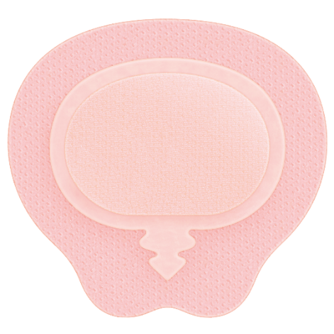
The ALLEVYN™ LIFE dressing range
With a wide range of shapes and sizes, ALLEVYN LIFE dressings are designed to conform to the body,
helping to enable patient comfort during wear¹⁵
ALLEVYN LIFE
(four sizes)
ALLEVYN LIFE Heel
(one size)
ALLEVYN LIFE Sacrum
(two sizes)

Slide 13
ALLEVYN™ LIFE in sacral pressure injury (PI) prevention⁴
Forni C, D’Alessandro F, Gallerani P, et al. Effectiveness of using a new polyurethane foam multi-layer dressing in the sacral area to prevent the onset of pressure ulcer
in the elderly with hip fractures: A pragmatic randomised con-trolled trial. Int Wound J. 2018; 15(3):383-390
An investigator-initiated study
A pragmatic, randomised, controlled, parallel-group superiority trial conducted at a single orthopaedic hospital in Italy
Patients aged ≥65 years with hip fracture without PIs
in the sacral area
  ALLEVYN LIFE + standard preventive care: 177 patients
  Standard preventive care alone: 182 patients
ALLEVYN LIFE was applied only to the sacrum region within 24hr of hospital admission
  Replaced when unstuck, wet or dirty after frequent skin inspections
The first independent, randomised, controlled, pragmatic superiority trial evaluating whether ALLEVYN LIFE can help to reduce the incidence of sacral PIs
in elderly patients with hip fracture

Slide 14
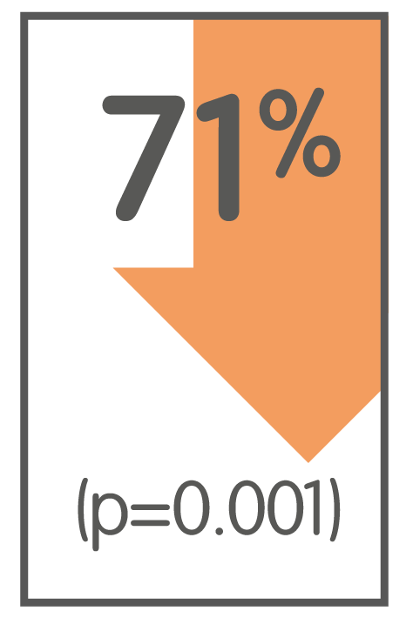
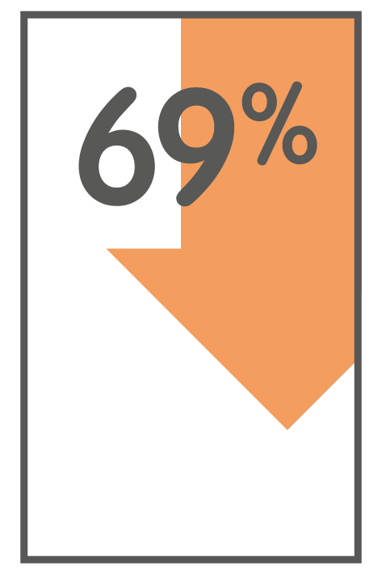
ALLEVYN™ LIFE in sacral PI prevention: key findings^{4,22}
Forni C, D’Alessandro F, Gallerani P, et al.
relative reduction
in sacral PI incidence with ALLEVYN LIFE (n=177) vs standard preventive care (n=182)
There was
an overall
cost-saving
of 69.2%
vs using
standard preventive
care alone²²
Pressure injury incidence
was only reduced where ALLEVYN LIFE was applied
Adhesiveness of ALLEVYN LIFE minimised
the need for dressing changes, helping to keep
costs low; the dressing did not roll back or detach

Slide 15
Other pressure injury prevention solutions

Slide 16
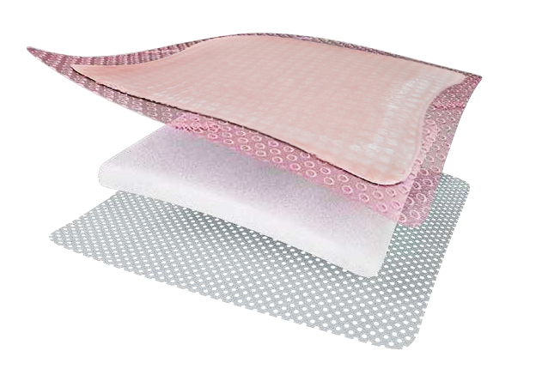
ALLEVYN™ Gentle Border and pressure injury prevention
ALLEVYN Gentle Border can be used for pressure injury prevention on intact skin, including prevention of pressure injuries caused by medical devices, as part of a pressure injury prevention protocol
A three-layer foam dressing
Breathable^{23,24}
bacterial barrier topfilm²⁵
Absorbent^{23,24} ALLEVYN polyurethane foam
Each of the layers contribute specific attributes
to the overall dressing action
Gentle²⁶ silicone adhesive
wound contact layer

Slide 17
ALLEVYN™ Gentle Border – use in pressure injury prevention programs
Consider using dressings that demonstrate pressure redistribution and absorb moisture from body areas in contact with medical devices, tubing and fixators²⁷
ALLEVYN Gentle Border redistributes pressure
(in vitro),^{22,23} can be cut,²⁸ lifted and repositioned on intact skin without losing its adherent properties²⁹
Medical devices should continue to be removed, lifted and/or moved for regular skin inspections and repositioned for pressure relief in accordance with local protocols²⁷
The results of in vitro simulation testing have not been proven to predict clinical performance

Slide 18
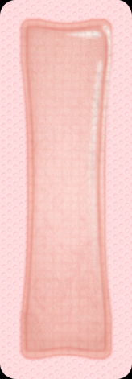
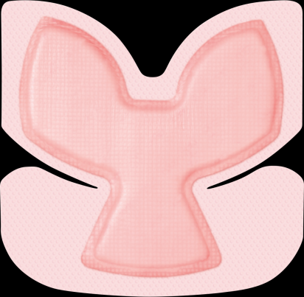
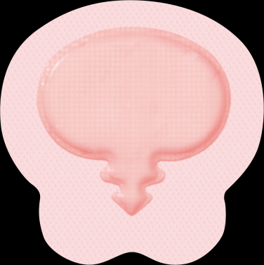
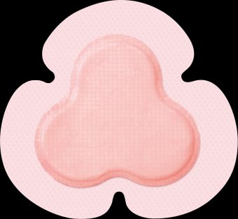
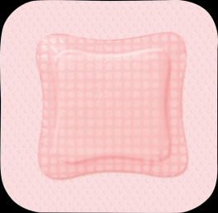
ALLEVYN™ Gentle Border: a range of shapes and sizes
Square
(four sizes)
Rectangle
(three sizes)
Multisite
(one size)
Sacrum
(one size)
Heel
(one size)

Slide 19

Recommendations for skincare to prevent pressure injuries^{9,30}
Published international guidelines have made recommendations for skincare to help prevent pressure injuries⁹
Avoid positioning the individual on an area of erythema whenever possible
Keep the skin clean and dry – use a pH balanced skin cleanser
Do not massage or vigorously rub skin that is at risk of pressure ulcers
Develop and implement an individualised continence management plan.
Cleanse the skin promptly following episodes of incontinence
Consider using a skin moisturiser to hydrate dry skin in order to reduce risk
of skin damage
Protect the skin from exposure to excessive moisture with a barrier product
in order to reduce the risk of pressure damage

Slide 20
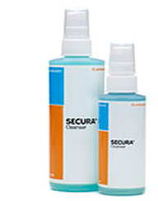
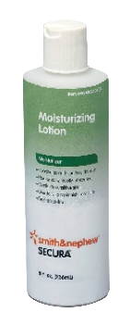
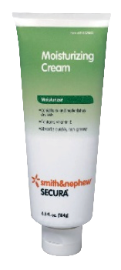
The SECURA™ skin care range can contribute to pressure injury reduction as part of a wider care plan^{9,30}
Cleanser
Moisturizers
SECURA™ cleanser
No rinse, head to toe cleansing
Formulated to clean sensitive skin areas and is pH balanced to help protect the skins natural acid mantle.³¹.
On application it creates a protective film over the skin³² which helps to protect against moisture loss which may lead to skin breakdown.
Suitable for periwound cleansing when using ALLEVYN™ dressing³³
SECURA™ moisturizing cream
and SECURA™ moisturizing lotion
Non-irritating, non-sensitizing and non-toxic³⁴⁻³⁶

Slide 21
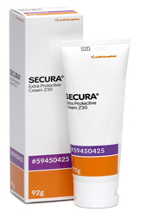
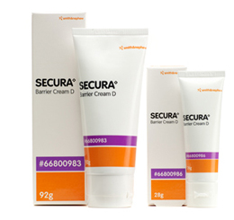
The SECURA™ skin care range can contribute to pressure injury reduction as part of a wider care plan^{9,30}
Barriers/protectants
SECURA Extra protective cream (EPC)
Protects skin from maceration³⁸
Treatment and prevention of rash associated with exposure to faeces or urine³⁸
SECURA™ dimethicone protectant
Helps protect skin from maceration
Maintains skin integrity by protecting the skin from exposure to faeces, urine and bodily fluids
Helps reduce skin breakdown²¹ associated with incontinence

Slide 22
Skin preparation
  NO-STING SKIN-PREP™
Effective water-resistant barrier for up to 96 hours⁴¹,under normal, non-adhesive use
Rapid drying time of under 30 seconds⁴²
Helps to protect skin integrity from trauma during tape and adhesive removal⁴³

Slide 23
References
Balzer K, Kottner J. Editorial: Evidence-based practices in pressure ulcer prevention: Lost in implementation? Int. J of Nursing Studies. 2015; 52 (11) 2618:1655-1658
Chiari P, Forni C, Guberti M, Gazineo D, Ronzoni S, D'Alessandro F. Predictive factors for pressure ulcers in an older adult population hospitalized for hip fractures:
a prognostic cohort study. PLoS One. 2017;12:e0169909
Haleem S, Heinert G, Parker M. Pressure sore and hip fractures. J Care Inj. 2008; 39: 219-223.
Forni C, D’Alessandro F, Gallerani P, et al. Effectiveness of using a new polyurethane foam multi-layer dressing in the sacral area to prevent the onset of pressure ulcer
in the elderly with hip fractures: A pragmatic randomised con-trolled trial. Int Wound J. 2018; 15(3):383-390
Black J, Fawcett D, Scott S. Ten top tips: preventing pressure ulcers in the surgical patient. Wounds Int. 2014; 5(4): 14-18
Cox J. Pressure Ulcer Development and Vasopressor Agents in Adult Critical Care Patients: A Literature Review. Ostomy wound management 2013; 59(4): 50-60
Liu P, Shen W, Chen H. The Incidence of Pressure Ulcers in the Emergency Department: A Meta-analysis. Wounds. 2017; 29 (1): 14-19
Kayser S, VanGilder C, Ayello E, Lachenbruch C. Prevalence and Analysis of Medical Device-Related Pressure Injuries: Results from the International Pressure Ulcer Prevalence Survey. Advances in skin & wound care 2018; 31(6):276-285
National Pressure Ulcer Advisory Panel, European Pressure Ulcer Advisory Panel and Pan Pacific Pressure Injury Alliance. Prevention and Treatment of Pressure Ulcers: Quick Reference Guide. Emily Haesler (Ed.). Cambridge Media: Osborne Park, Australia; 2014
Dreyfus J, Gayle J, Trueman P, Delhougne G, Siddiqui A. Assessment of Risk Factors Associated With Hospital-Acquired Pressure Injuries and Impact on Health Care Utilization and Cost Outcomes in US Hospitals. Am J Med Qual. 2018;33(4):348-358
World Union of Wound Healing Societies (WUWHS) Consensus Document. Role of dressings in pressure ulcer prevention. Wounds International, 2016.
International consensus. Optimising wellbeing in people living with a wound. An expert working group review. London: Wounds International, 2012.
Byrne J, Nichols P, Sroczynski M, et al. Prophylactic Sacral Dressing for Pressure Ulcer Prevention in High-Risk Patients. Am J. of Crit Care.2016; 25 (3): 228-235
Rossington, A. Pressure transmission testing of ALLEVYN™ LIFE when wet and dry, MepilexTM Border and OptifoamTM Gentle.
Data on File report DS/18/351R-September 2018.
A. Rossington. Product performance of the next generation ALLEVYN™ LIFE. Data on File report GMCA-DOF/08-April 2016
Daubney. Physical testing ALLEVYN™ LIFE Gen2. Data on File Report DS/15/025/R- May 2016

Slide 24
References
Mumby E. Subjective comparison of masking ability of ALLEVYN™ LIFE Gen2. Data on File Report DS/16/061R.- Feb 2016
Earl K. Wound model testing of ALLEVYN™ LIFE Gen2 using horse serum. Data on File Report DS/14/303/R.- April 2016
ALLEVYN™ Life vs MepilexTM Border – Product Retention Performance Testing. Data on File report HVT080 September 2018
Clarke R. Positive patient outcomes: The use of a new silicone adhesive foam dressing for pressure ulcer prevention and treatment. Poster presented
at the Canadian Association for Enterostomal Therapy (now the Nurses Specializing in Wound, Ostomy and Continence Canada [NSWOCC])
National Conference. May 9–12, 2013, Ottowa, Canada
Lisco C. Evaluation of a new silicone gel-adhesive hydrocellular foam dressing as part of a pressure ulcer prevention plan for ICU patients. Poster 1599
presented at the Wound, Ostomy and Continence Nurses Society Annual Conference. June 22–26, 2013. Seattle, USA
Forni C, Searle R. Economic evaluation of the use of a multi-layer polyurethane foam dressing for the prevention of pressure ulcers in elderly patients
with hip fractures. Poster presented at EPUAP annual meeting, September 2018
Smith & Nephew Data on File DS/16/461/Rv3 ALLEVYN Gentle Border - Physical Evaluation
Smith & Nephew Data on File DS/16/462/Rv3 ALLEVYN Gentle Border Heel - Physical Evaluation
Smith & Nephew Data on File 1010016 Bacterial Barrier Testing (wet-wet) on samples of Allevyn™ Gentle and Allevyn™ Gentle Border dressing with a 7 day test
duration against S. marcescens
Hurd T, Gregory L, Jones A, Brown S. "A multi-centre, in market evaluation of ALLEVYN Gentle Border“. Wounds UK; 2009 (5):32-44
Black J, Alves P, Brindle CT, et al. Use of wound dressings to enhance prevention of pressure ulcers caused by medical devices. Int Wound J. 2015;12(3):322-7
Smith & Nephew Data on File DS/14/318/R - Cutting of Allevyn Variants.
Erakli D. ALLEVYN Gentle Border dressings assessment in terms of retention on thighs. Smith & Nephew Medical Ltd. GMCA-DOF/04-December 2015
Satterwhite J, Smith K, Norton R, McKelvey L, Clark J. A patient safety goal: Preventing the incidence of pressure ulcers in the hospitalized patient resulting in a positive outcome and a reduction in associated costs. University Medical Center, Lubbock, Texas. Poster created 2006
Brett. D., Justification of pH Buffered formulation for Secura Total Body Foam Cleanser. 2017.
Brett, D. W. Plante, L. An In Vitro Assessment of the Efficacy of an Antimicrobial Skin Cleanser on the Pathogens often Associated with Urinary Tract Infection (UTI).
Norton, R. Prevention Focus Expands at University Medical Center: Positive Clinical and Economic Outcomes Sustained, 2008.

Slide 25
References
Delayed Contact Sensitization Study (Repeated Patch Method) in the Guinea Pig - Report #93C-21027-00, NAmSA
Acute Oral Toxicity Study (FHSA) in the Rat – Report #94T -01784-00, NAmSA
Evaluation of Cumulative Irritation Potential in Humans (21-day), Report # 94-2404-72A, Hill Top Research
Brett, D. The Justification Of Moisturizing Cream (Mcr) Claim Of Non-Greasy/Non-Staining/ Fast Absorbing Formula That Saves Valuable Nursing Time. 2017
Monograph Title 21 CFR Part 347 - Skin Protectant Drug Products for Over the Counter Human Use (Final Monograph 06/2003)
Brett, D. : The justification of Secura Anti-Fungal Extra Thick Cream formulated to not wash away even in severe cases of diarrhea and soothing and gentle to the skin. 2017.
Title 21 CFR, Part 333, SubpartC - Topical Antifungal Drug Products
Study to determine the wash off resistance and Durability of a Barrier Film. Rpt # 09-58A.
Assessment of the Time to Dry of a No Sting Barrier Film. 2009.
Skin Protectant Barrier Test: No-Sting Barrier Film. SAP, 2009
Data on File – Anderson, Larry, R&D/CMC (Forth Worth), Ingredient Function Certification, 03 Feb 2016, PROSHIELD Foam & Spray Cleanser
Data on File – Technical file PROSHIELD Foam & Spray incontinence cleanser (product formulation/ specifications)
Title 21 CFR Part 347 – Skin protectant drug products for over-the-counter human use (Final Monograph, 06/2003)
Data on File – Anderson, Larry, R&D/CMC (Forth Worth), Does Not Contain Ingredients Certification 11 Feb 2016 – PROSHIELD Plus Skin Protectant.
Data on File - Technical File Proshield Plus Skin Protectant (Product Formulation/Specifications)
Beeckman D et al, Proceedings from the Global IAD Expert Panel, Incontinence-Associated Dermatitis: Moving Prevention Forward, Wounds International 2015, Available to download from www.woundsinternational.com
Flynn D, Williams S. Barrier creams for skin breakdown, Nursing & Residential Care. 2011; 13 (11): 553-558
Maxwell J, Sinclair D. Treatment of moisture related lesions in children. Great Ormond St Hospital for Children NHS Foundation Trust, London UK. Poster presented at EWMA 2012, Vienna, Austria.
Meuleneire, F. A new solution in the treatment of moisture lesions. AZ St Elisabeth Zottegem, Belgium. 2012
Wall L, Vernon T. Launch of a Skin Care Regime to reduce the incidence of Moisture Associated Skin Damage. Doncaster and Bassetlaw NHS Foundation Trust, 2015

