Slide 1
Clinical and economic results of switching to ALLEVYN◊ LIFE Foam Dressing from various standard dressings in a community-based study
Tiscar-González V, et al. Adv Skin Wound Care. In press (with permission).
Confidential – For internal use only by Smith & Nephew employees and sales force. This information may not be publicly disclosed or distributed.

Slide 2
Evidence summary
47.1%
Significant relative reduction in mean dressing change frequency from baseline to Week 4
(1.48 fewer changes per week; p<0.001)
Results of this study conducted in the community setting in Spain showed that after switching to ALLEVYN◊ LIFE Foam Dressing from previous dressings:¹
Improved treatment satisfaction for healthcare professionals (HCPs) and patients
€16.29
Reduction in mean weekly dressing costs per patient
(58.7% relative reduction; p<0.001)
Confidential – For internal use only by Smith & Nephew employees and sales force. This information may not be publicly disclosed or distributed.

Slide 3
Background and aims
Chronic wounds are a major burden to healthcare systems²
In Europe, management of chronic wounds accounts for 2–4% of total healthcare budgets³
Conservative estimates of Medicare spending for chronic wound care in the USA was $28.1 billion in 2014⁴
Materials and dressings represent 15-20% of total costs in wound management⁵
80–85% of total costs are due to nursing time and hospital costs⁵
Reductions in dressing change frequency can help to improve efficiency⁵
Main cost drivers for wound care materials and dressings:⁵
Frequency of dressing changes
Time to heal
Wound complications
Could switching to ALLEVYN◊ LIFE Foam Dressing from various standard dressings improve efficiency and quality of wound management in a Spanish community setting?¹
Confidential – For internal use only by Smith & Nephew employees and sales force. This information may not be publicly disclosed or distributed.

Slide 4
Study design and patients
An ambispective (retrospective and prospective) multicentre observational study conducted in Spain between November 2017 and March 2019¹
30
community centres
primary care (24 centres) nursing homes (6 centres)
94
patients
(128 wounds)
requiring occlusive dressings with expected follow-up of ≥3 weeks
4
weeks
follow-up after switching to ALLEVYN◊ LIFE Foam Dressing from previous dressings (includes foams, 42.0% and gelling fibres, 21.0%)
Confidential – For internal use only by Smith & Nephew employees and sales force. This information may not be publicly disclosed or distributed.

Slide 5
Study interventions
Prior to introduction of ALLEVYN◊ LIFE Foam Dressing, baseline data were captured including wound assessments and current dressing type¹
ALLEVYN LIFE Dressing was applied according to routine clinical practice as either primary (35.2%) or secondary dressing (64.8%)*
Four sizes of ALLEVYN LIFE Dressing were used (10.3×10.3cm, 12.9×12.9cm, 15.4×15.4cm and 21.0×21.0cm)
*Due to debridement, suspected infection, desloughing or packing of deep wounds.
Confidential – For internal use only by Smith & Nephew employees and sales force. This information may not be publicly disclosed or distributed.

Slide 6
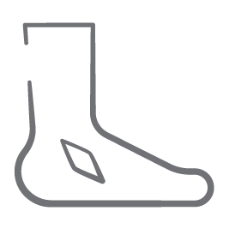
Study endpoints¹
Primary endpoint
Mean dressing change frequency versus baseline (previous dressings)
Other endpoints
Treatment costs (Spanish National Healthcare System perspective)
Change in wound size
Treatment satisfaction was assessed at:
Baseline and final visit for patients (5-point scale)
Final visit for HCPs (3-point scale)
Confidential – For internal use only by Smith & Nephew employees and sales force. This information may not be publicly disclosed or distributed.

Slide 7
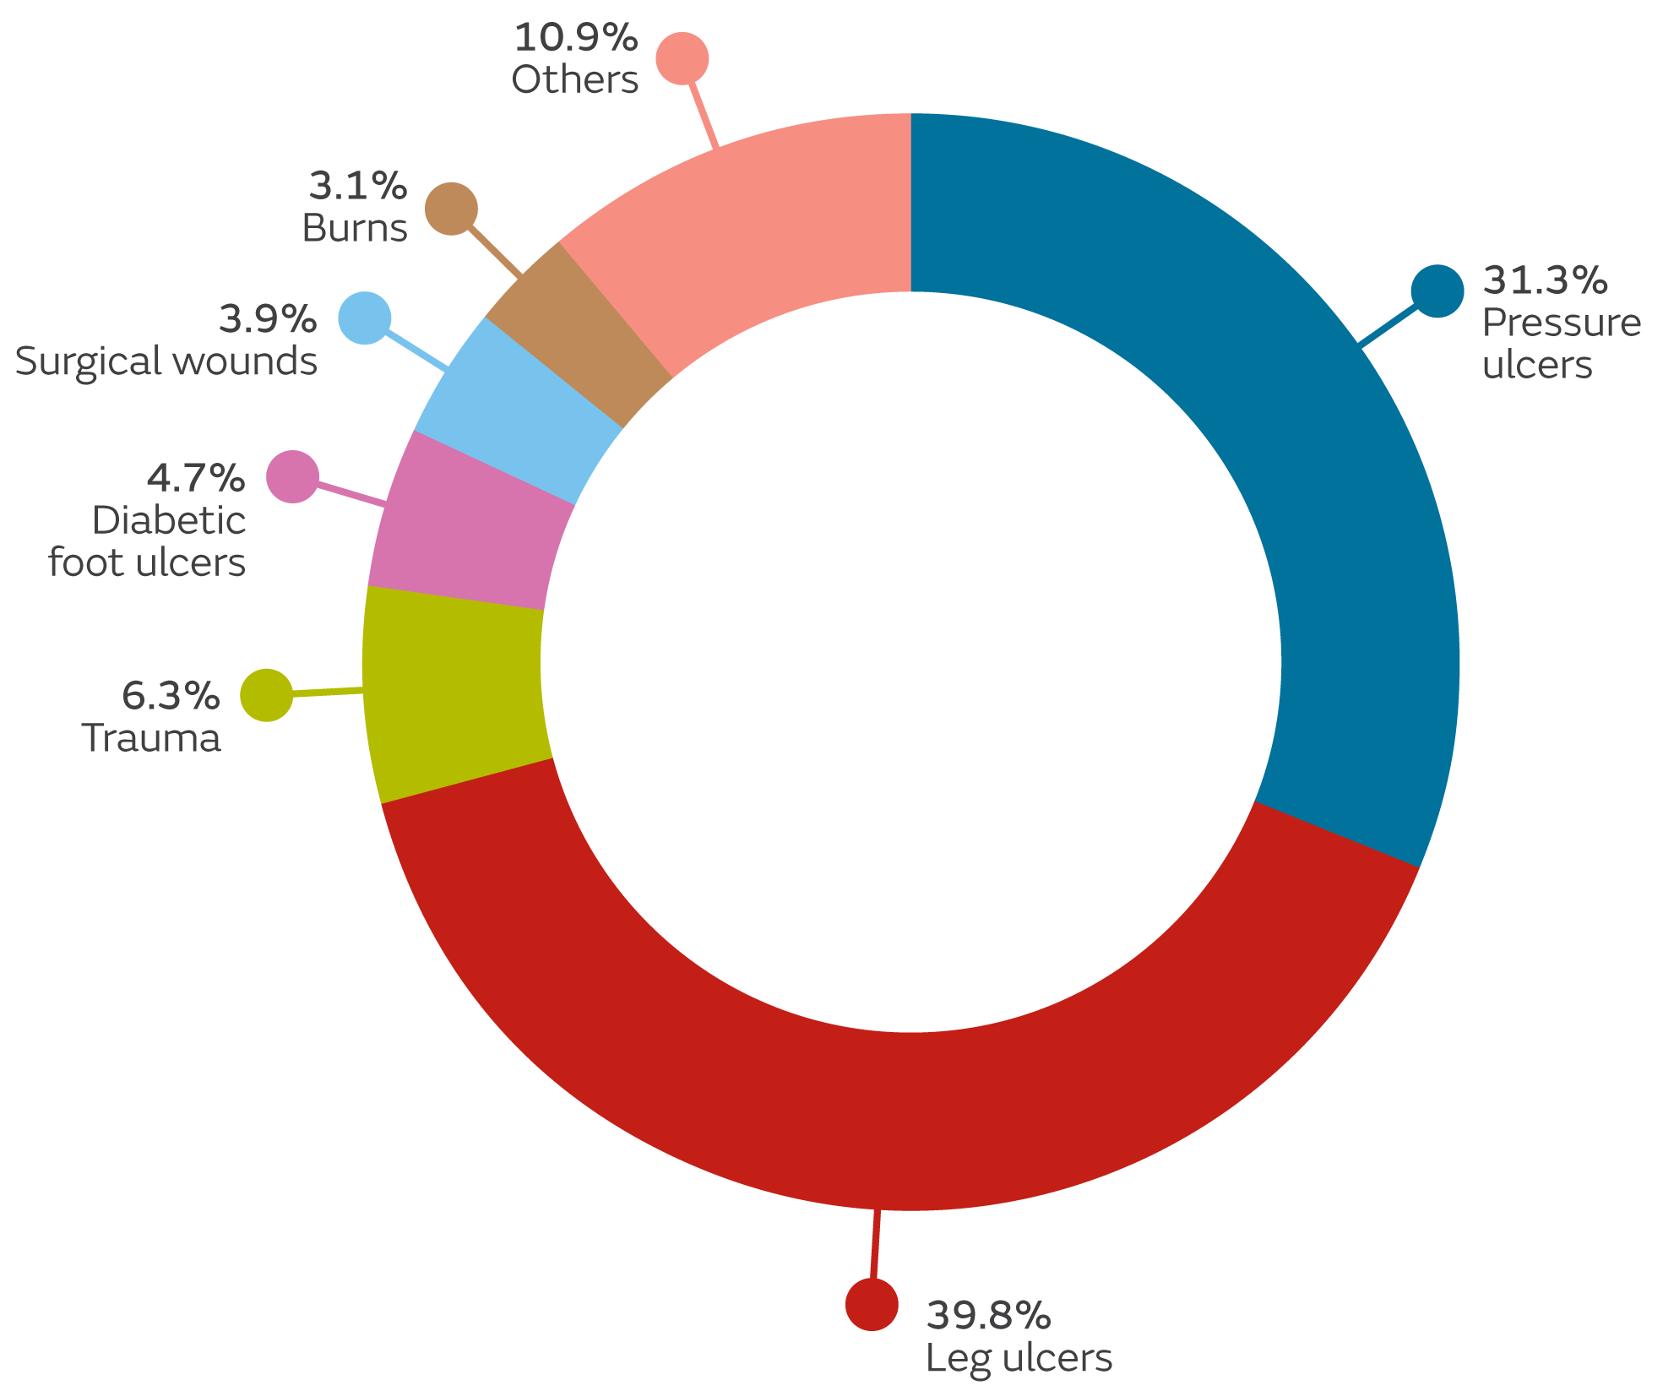
Wound characteristics at baseline¹
Most wounds were
2-10cm² in area at baseline
Pressure injuries
23%
>10cm²
(n=29)
>70%
of wounds were pressure ulcers or leg ulcers¹
55%
2–10cm²
(n=70)
22%
<2cm²
(n=28)
Confidential – For internal use only by Smith & Nephew employees and sales force. This information may not be publicly disclosed or distributed.

Slide 8
Significant reduction in frequency of dressing changes with ALLEVYN◊ LIFE Foam Dressing versus previous dressings¹
1.48 fewer
dressing changes per week
(47.1% relative reduction;
p<0.001)
4
Changes in reasons for dressing change during the study:
3
3.14
50%
‘routine change’, ‘dressing saturated’ and ‘stained dressing’
after implementing ALLEVYN LIFE Dressing compared with previous dressings
Mean number of dressing changes per week
2
1.66
1
0
Baseline (previous dressings)
ALLEVYN LIFE Dressing (Week 4)
Confidential – For internal use only by Smith & Nephew employees and sales force. This information may not be publicly disclosed or distributed.

Slide 9
Use of ALLEVYN◊ LIFE Foam Dressing significantly reduced mean weekly dressing costs versus previous dressings¹
Cost analysis (weekly, per patient) | Previous dressings | ALLEVYN LIFE Dressing
Mean dressing cost | €27.75 (±94.60) | €11.46 (±10.23) | p<0.001
Mean dressing cost + mean nursing time cost† | €108.82 (±123.70) | €55.78 (±33.67) | p<0.01
Mean±standard deviation; †Estimated mean cost of each nurse visit was €27.79
Even at its lowest and highest prices, use of ALLEVYN LIFE Dressing significantly reduced mean weekly dressing costs per patient versus previous dressings (p<0.005)
58.7%
relative reduction
in mean weekly dressing costs
(€16.29 saving; p<0.001)
Confidential – For internal use only by Smith & Nephew employees and sales force. This information may not be publicly disclosed or distributed.

Slide 10
Subgroup analysis: pressure injuries and leg ulcers¹ Reductions in mean dressing change frequency and mean weekly costs
Switching to ALLEVYN◊ LIFE Foam Dressing from previous dressings resulted in:
Pressure ulcers
Leg ulcers
45%
Relative reduction in mean dressing change frequency
(from 3.43 to 1.90; p<0.001)
49%
Relative reduction in mean dressing change frequency
(from 3.10 to 1.58; p<0.001)
75%
Relative reduction
in mean weekly costs
(from €47.99 to 11.80; p<0.001)
35%
Relative reduction
in mean weekly costs
(from €20.07 to 13.00; p<0.001)
Confidential – For internal use only by Smith & Nephew employees and sales force. This information may not be publicly disclosed or distributed.

Slide 11
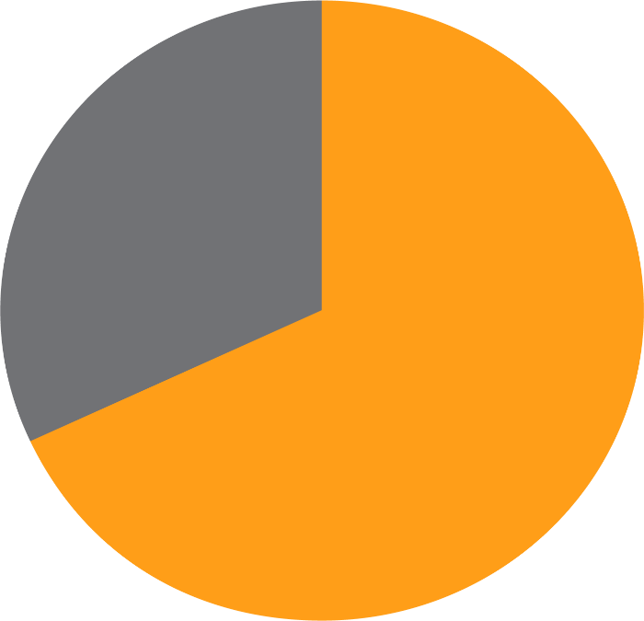
HCPs were more satisfied with use of ALLEVYN◊ LIFE Foam Dressing than previous dressings¹
HCPs agreed that after switching to ALLEVYN LIFE Dressing most wounds showed improvements in:
Size (mean area), pain, smell and exudate level
Most HCPs rated ALLEVYN LIFE Dressing ‘better’ than previous dressings (all assessed performance characteristics)
Exudate masking
88%
Indicating change
81%
Ease of removal
67%
Overall performance 68%
92.2% of HCPs said they would recommend ALLEVYN LIFE Dressing
within their healthcare organisation
Ease of use
65%
Involve patient/caregiver
61%
Adaptability to wound size
51%
ALLEVYN LIFE Dressing rated better than previous dressings (%)
Confidential – For internal use only by Smith & Nephew employees and sales force. This information may not be publicly disclosed or distributed.

Slide 12
Patients were more satisfied with ALLEVYN◊ LIFE Foam Dressing than previous dressings¹
100
ALLEVYN LIFE Dressing
Previous dressings
78.7%
80
72.1%
74.6%
More patients rated ALLEVYN LIFE Dressing as ‘good’ or ‘very good’
compared with their previous dressings
60
Patient responses (%)
40
31.7%
27.4%
28.5%
90.2% of patients
said they would recommend their wound care provider
20
0
Overall experience
Exudate control
Dressing comfort
Confidential – For internal use only by Smith & Nephew employees and sales force. This information may not be publicly disclosed or distributed.

Slide 13
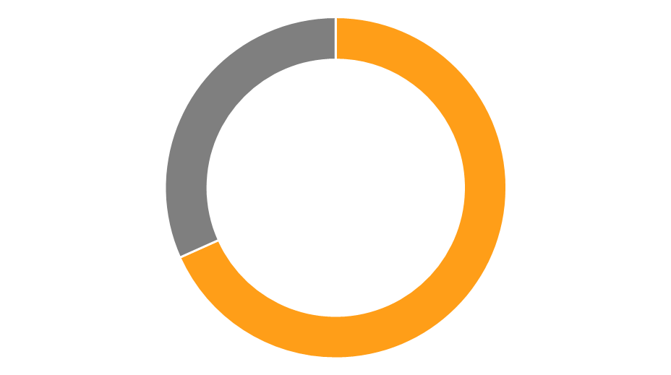
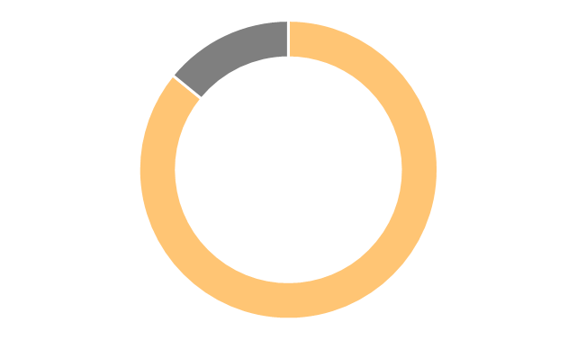
Mean wound area reduced significantly from baseline using ALLEVYN◊ LIFE Foam Dressing¹
Baseline
9.9cm²
68.3%
of wounds
had a reduction in mean wound area at Week 4 (n=71)
85.9%
of those wounds
had a reduction >30% (n=61)
28.3%
relative reduction
in mean wound area using ALLEVYN LIFE Dressing
(2.8cm²; p<0.001)
Week 4
7.1cm²
Confidential – For internal use only by Smith & Nephew employees and sales force. This information may not be publicly disclosed or distributed.

Slide 14
Summary
Frequency of dressing changes is a key cost driver for materials and dressings in wound management⁵
This study, conducted in the Spanish community setting, showed after switching to ALLEVYN◊ LIFE Foam Dressing from previous dressings:¹
47.1%
relative reduction in mean dressing change frequency from baseline to Week 4
(1.48 fewer changes; p<0.001)
€16.29
reduction in mean
weekly dressing costs per patient
(58.7% relative reduction; p<0.001)
Improved treatment satisfaction for HCPs and patients
Confidential – For internal use only by Smith & Nephew employees and sales force. This information may not be publicly disclosed or distributed.

Slide 15
References
Tiscar-González V, Rodriguez MJM, Rabadán Sainz C, et al. Clinical and economic impact of wound care using a polyurethane foam multi-layer dressing versus standard dressings on delayed healing ulcers. Adv Skin Wound Care. In press (with permission).
Frykberg RG, Banks J. Challenges in the treatment of chronic wounds. Adv Wound Care. 2015;4(9):560-582.
Kronert GT, Roth H, Searle RJ. The impact of introducing a new foam dressing in community practice. EWMA Journal. 2016;16(2):7-12.
Nussbaum SR, Carter MJ, Fife CE, DaVanzo J, Haught R, Nusgart M, Cartwright D. An economic evaluation of the impact, cost, and Medicare policy implications of chronic nonhealing wounds. Value Health. 2018;21(1):27-32.
Lindholm C, Searle R. Wound management for the 21st century: combining effectiveness and efficiency. Int Wound J. 2016;13:5-15.
Drew P, Posnett J, Rusling L. The cost of wound care for a local population in England. Int Wound J. 2007;4(2):149-155.
Confidential – For internal use only by Smith & Nephew employees and sales force. This information may not be publicly disclosed or distributed.

Slide 16
For detailed product information, including indications for use, contraindications, precautions and warnings, please consult the product’s applicable Instructions for Use (IFU) prior to use.
25616-anz V1 10/20

