Slide 1


ALLEVYN◊ LIFE Dressing Mode of action for
pressure injury prevention

Slide 2

Introduction
Smith+Nephew have worked with Professor Amit Gefen to investigate how the unique construction of ALLEVYN◊ LIFE Foam Dressings help to prevent pressure injuries.
Professor Amit Gefen: Tel Aviv University, Israel
President, European Pressure Ulcer Advisory Panel (EPUAP) [2013-2015]​
Awarded the Pressure Care Career Award by the World Union of Wound Healing Societies in 2016, the Experienced Investigator Award of EPUAP in 2017, and the Otto Schmitt Career Award of the International Federation of Medical & Biological Engineering (IFMBE) in 2018 for “exceptional contributions to the advancement of the field of medical and biological engineering”
Latest award from National Pressure Injury Advisory Panel (NPIAP) [2023] for pressure injury prevention science
Published more than 200 articles in peer-reviewed international journals

Slide 3
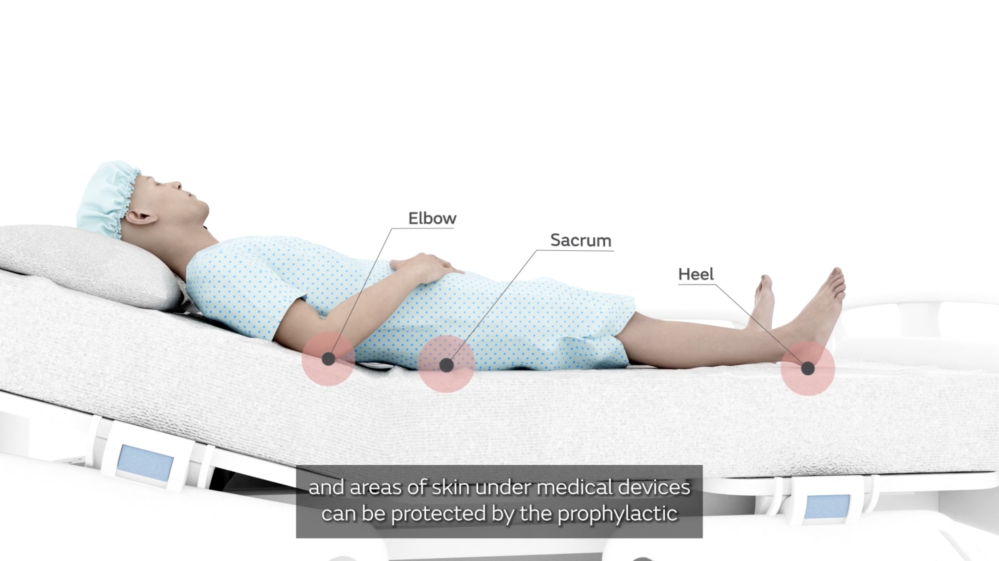
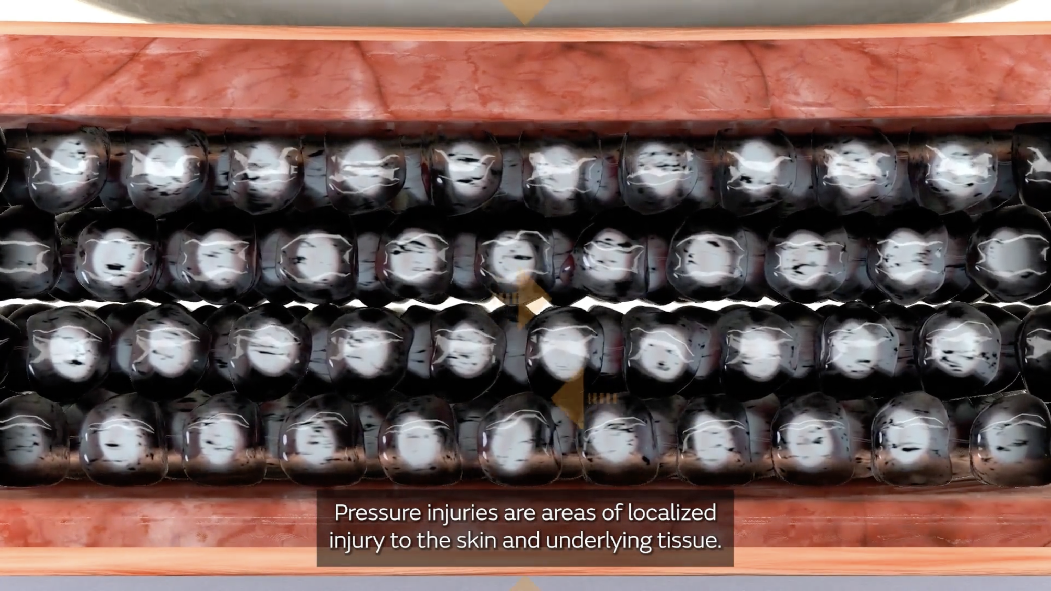
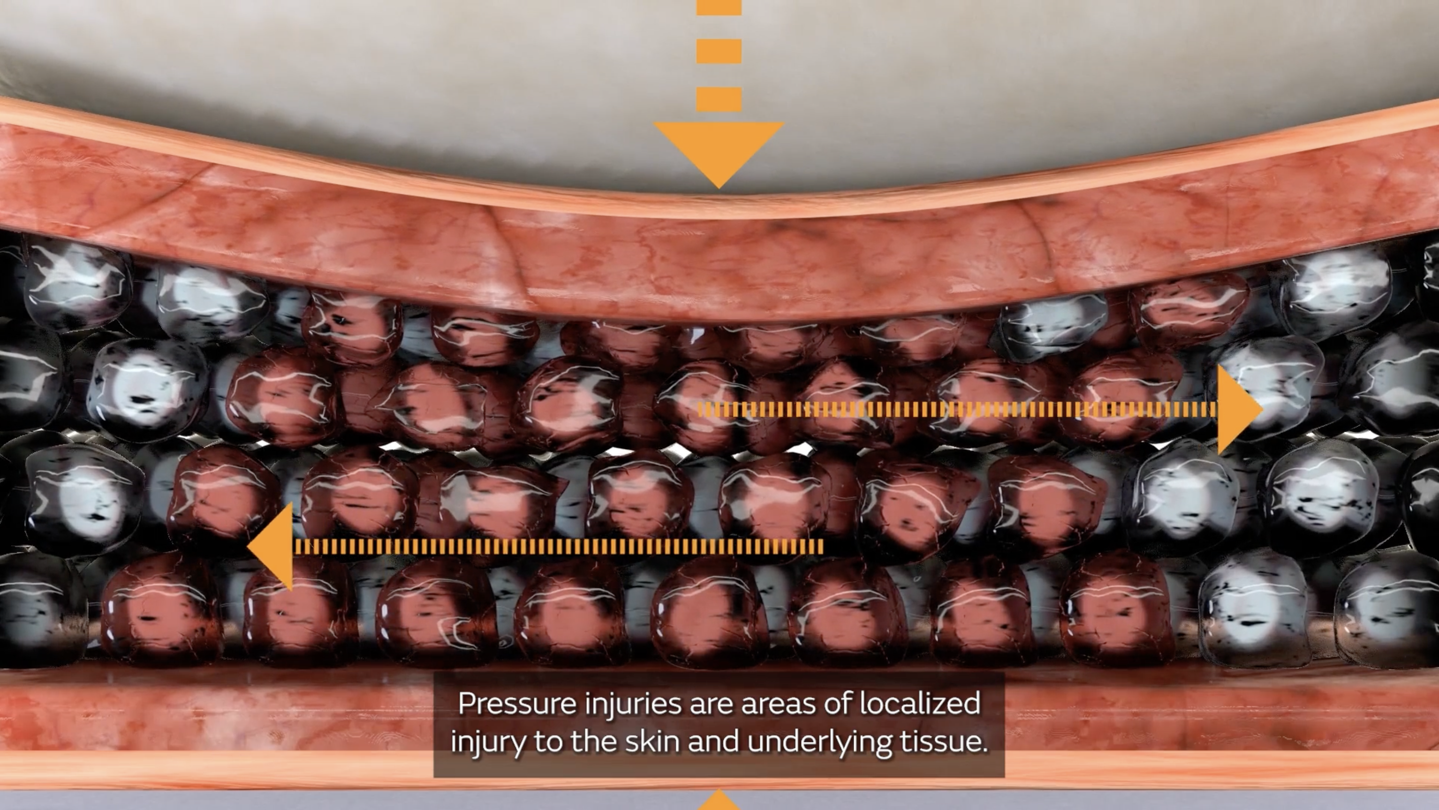
Pressure injuries
Tissue deformation in action
Pressure injuries are areas of localised injury to the skin and underlying tissue.
This is the result of sustained soft tissue deformations caused by pressure in combination with shear being applied to the skin.^{1,2}
Shear is a mechanical force that acts in a parallel direction to the surface, causing distortion of deformable bodies.
Friction is the resistance of a material when it is dragged across a surface quantified by a friction coefficient, contributing to the shear forces experienced.

Slide 4
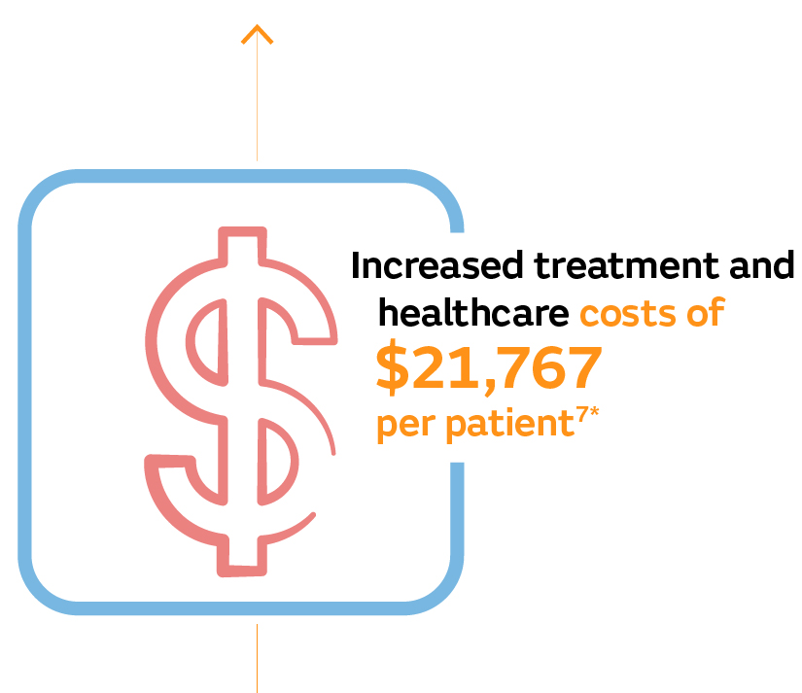
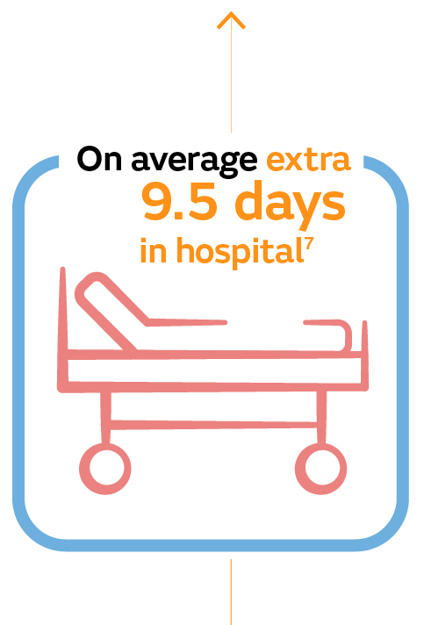
The impact of pressure injuries
1 out of 10 hospitalised adults are affected by hospital-acquired pressure injuries (HAPIs)³
Patients with HAPIs can have high readmission rates within 30 to 180 days of discharge,⁵ compared to patients without HAPIs
4
4*
HAPI complications can be life-threatening,⁴ painful and distressing,⁵ impacting patients, their families, caregivers and frontline staff.⁵
*On average

Slide 5
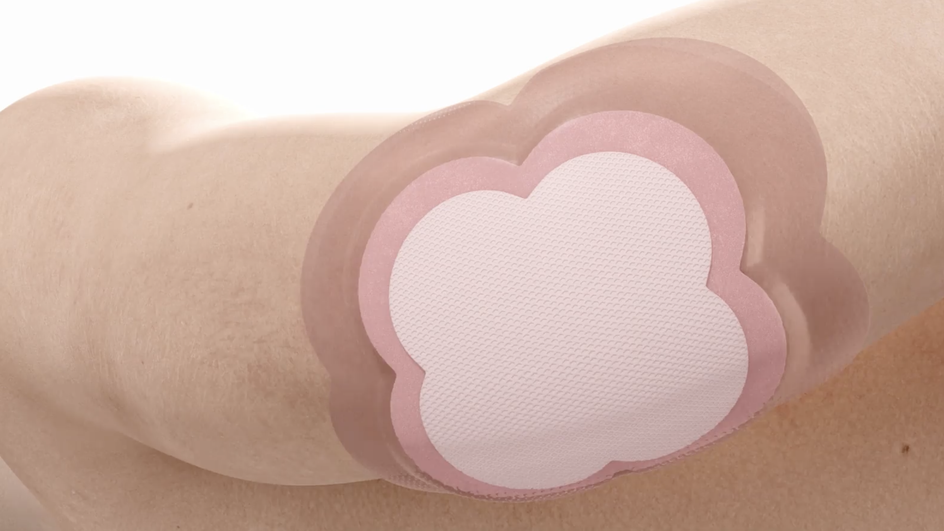
Guideline recommendations
International guidelines recommend the use of foam dressings as part of a comprehensive pressure injury prevention program and should be applied as early as possible in the care pathway.²
Foam dressings should be used in conjunction with other preventive measures.

Slide 6
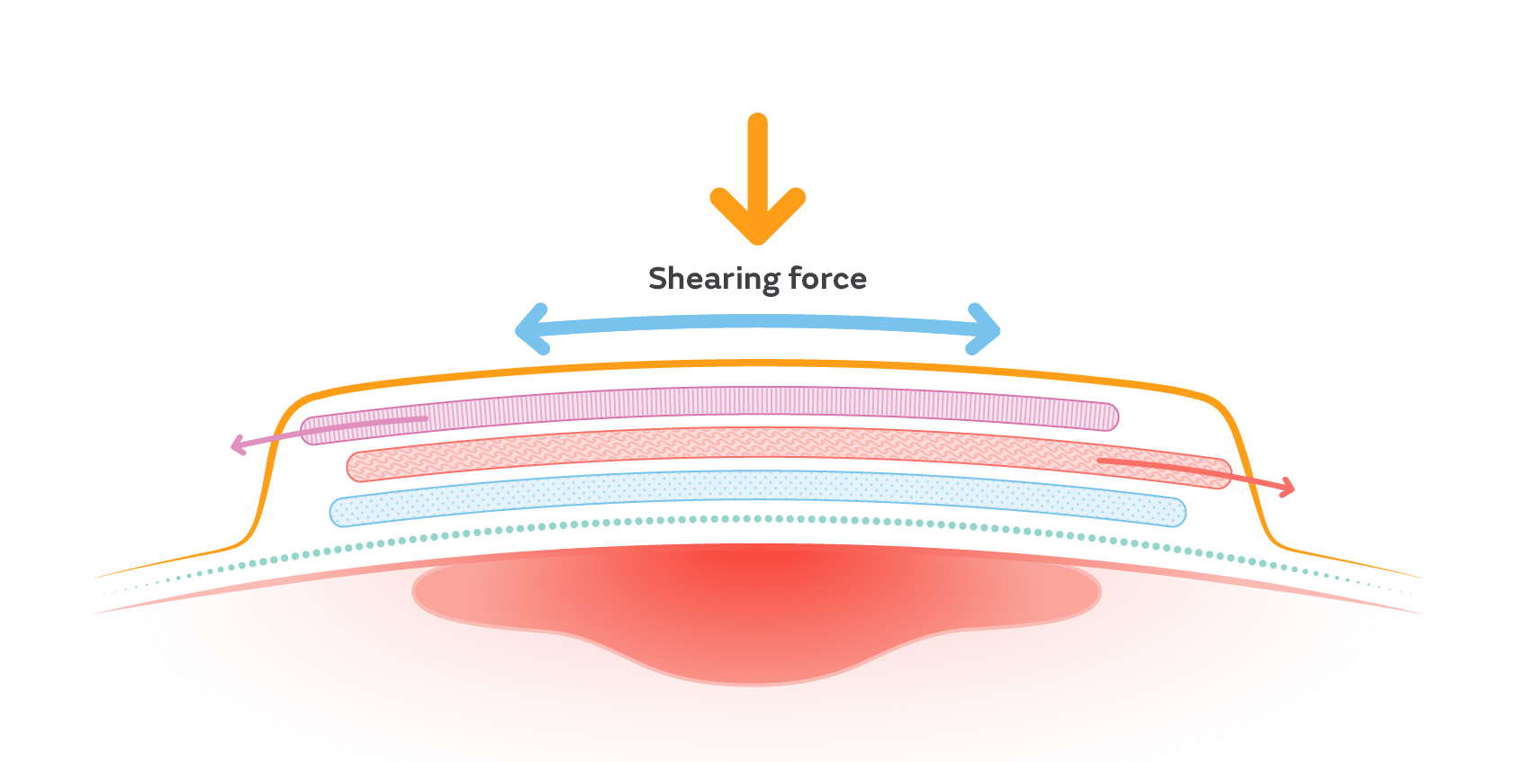
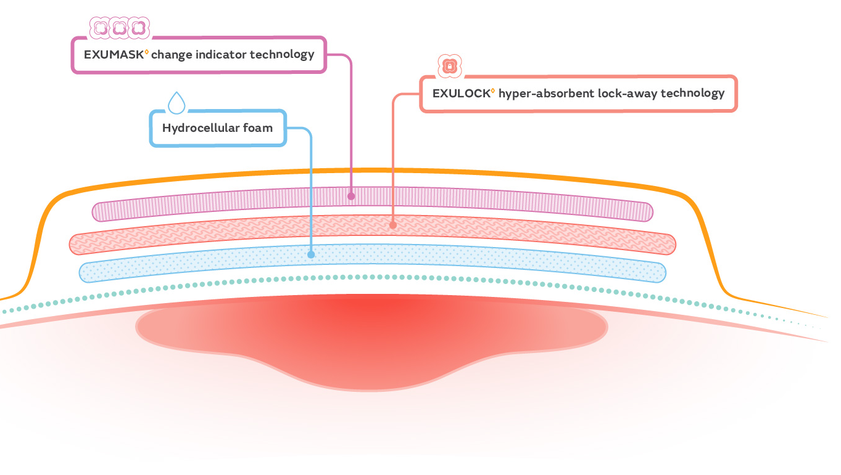
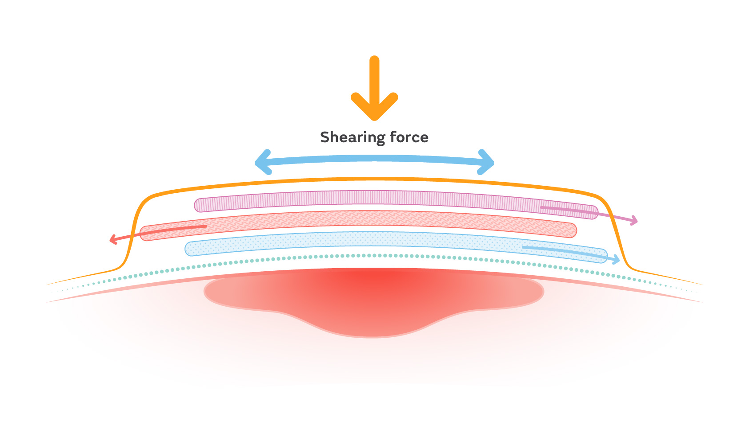
ALLEVYN◊ LIFE Dressing layers sliding movement
ALLEVYN LIFE Dressings have free, independent layers that slide against one another,^{*6} which can prevent the patient’s skin from moving.
The movement within the dressing absorbs energy that can deform and damage soft tissue.^{*6}
The dressing at rest with no shear force applied
The dressing with shearing force applied — the layers of the dressing slide against each other*
*As demonstrated in vitro

Slide 7
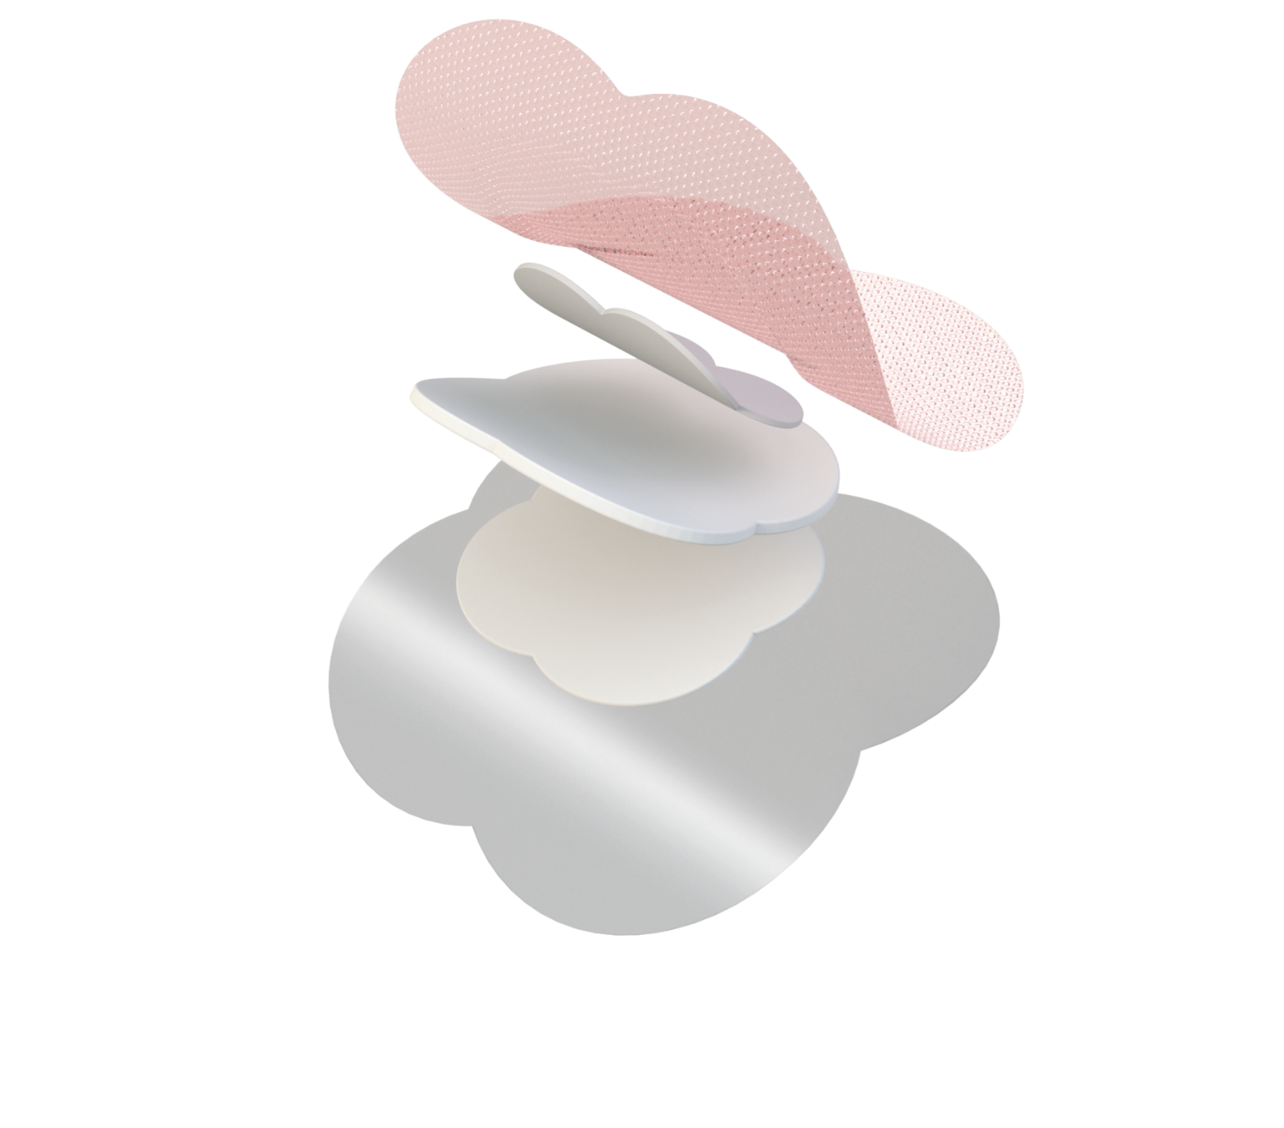
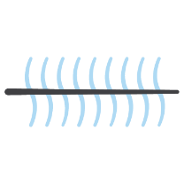
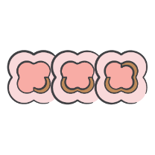

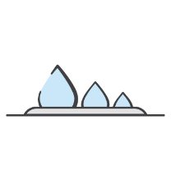

The independent layers of ALLEVYN◊ LIFE Dressing
The layers which form the pad of ALLEVYN LIFE Dressing are independent of one another.^{*6}
Breathable top film layer^{7,8}
Low coefficient of friction, reducing the generation of shear forces already at the external surface of the dressing¹⁴
EXUMASK◊ Masking Layer
Allows the dressing to move, which can prevent the patient’s skin from moving, so friction and shear forces are absorbed by the dressing^{*6}
Not attached to the
EXULOCK Layer
EXULOCK◊ Advanced
Lock-In Technology
Freely moves within the dressing that can help absorb friction and rubbing during patient movement^{*6}
Redistributes pressure and provides most of the cushioning^{*15}
Absorbent hydrocellular
foam layer^{9,10}
Not attached to the
EXULOCK Layer.
Allows the inside of the dressing to move, helping to absorb friction and rubbing^{*6}
Helps to remove moisture from the skin surface^{*12,14}
Gentle silicone wound
contact layer¹¹⁻¹³
*As demonstrated in vitro

Slide 8
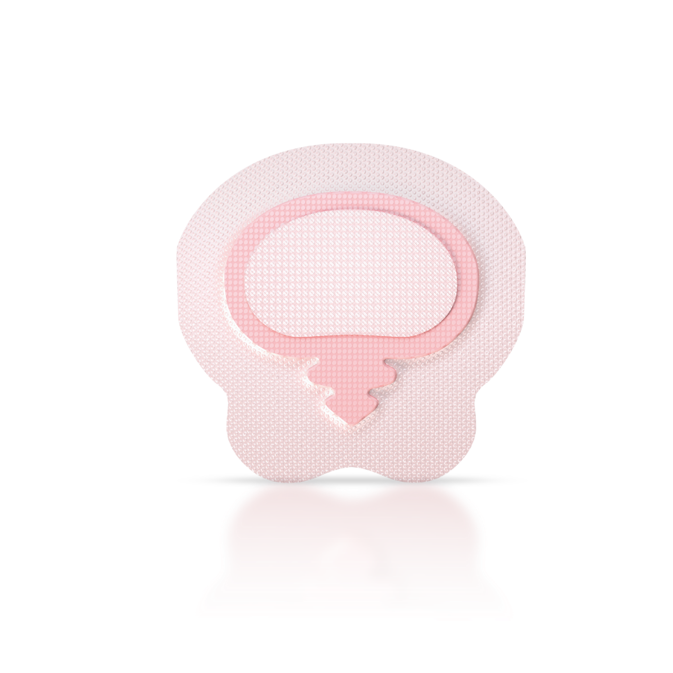
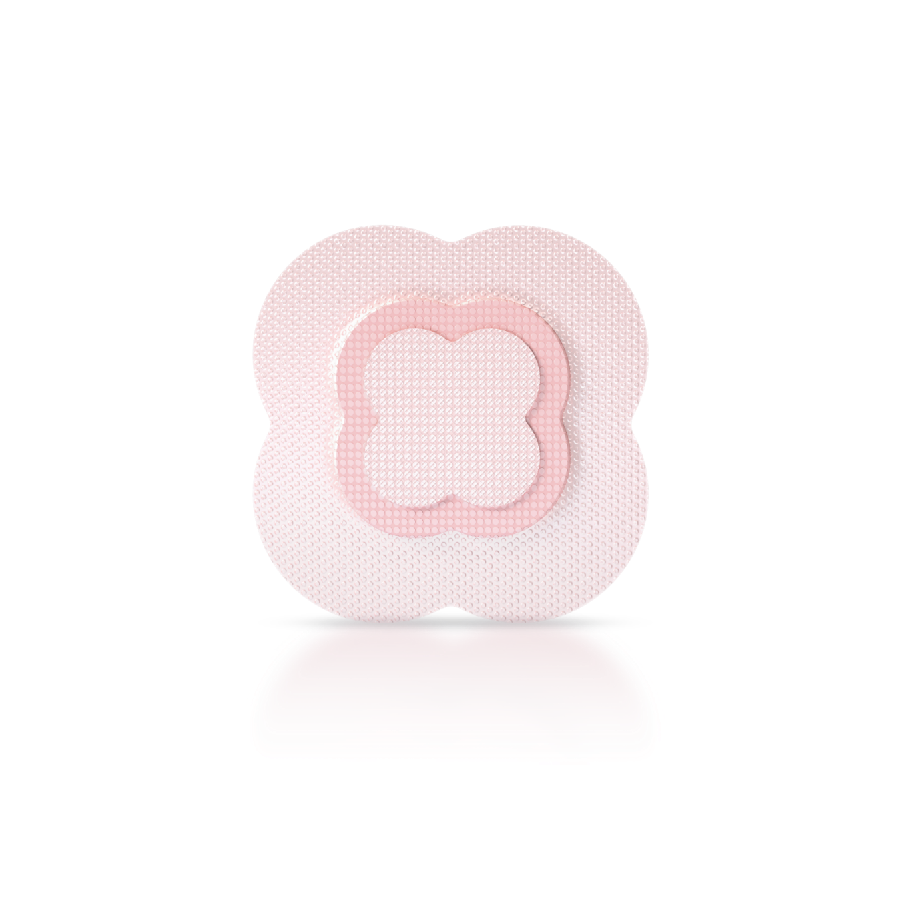
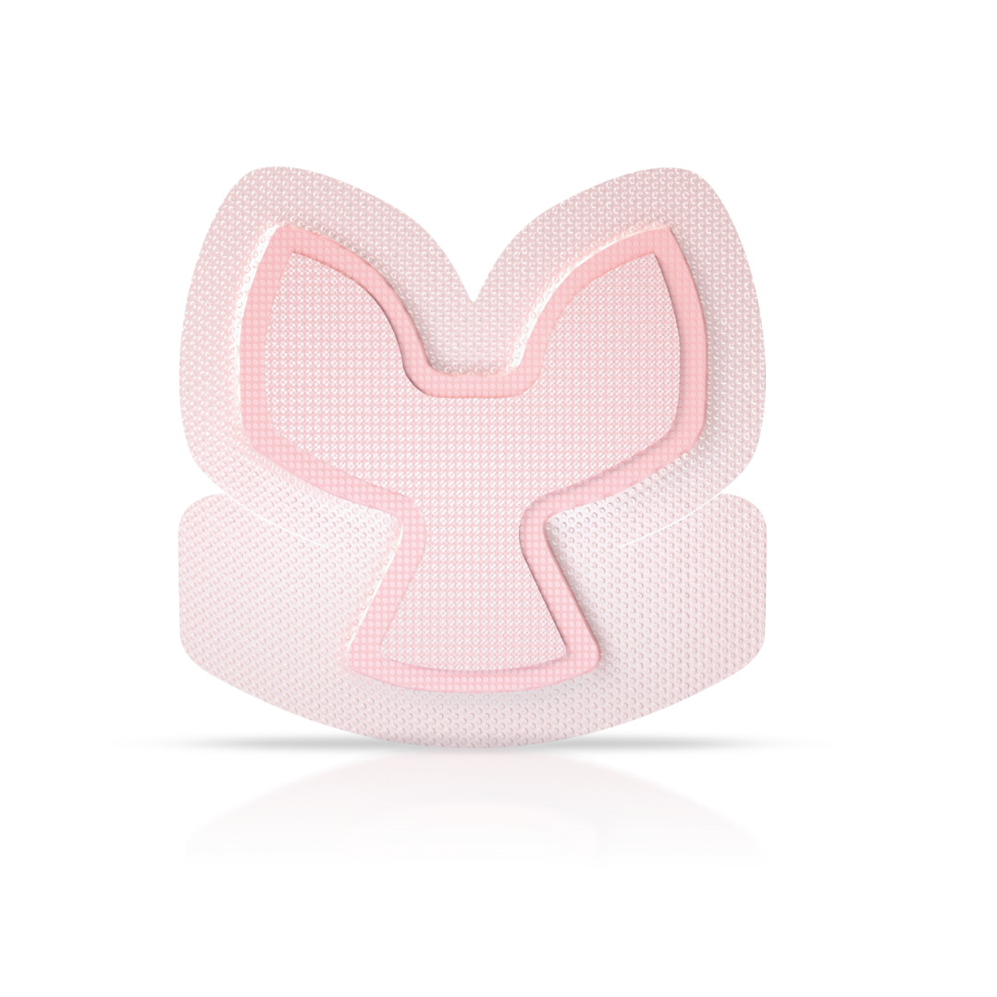
Proven to deliver frictional energy absorber effectiveness within the dressing due to its
truly independent layers^{*6}
* As demonstrated in-vitro

Slide 9
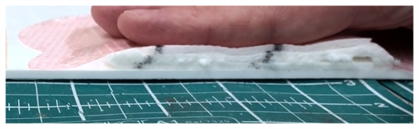
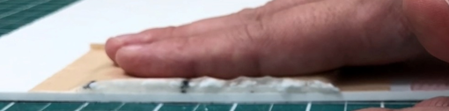
Competitor comparison
Cut a strip from a length of the dressing, allowing you to put the strip between your forefinger and thumb.
Rub the layers backwards and forwards with both hands to show they can move past each other.
The design of the ALLEVYN◊ LIFE Dressing has independent layers which form the dressing pad — this allows movement to occur within the dressing.^{*6}
For some competitor dressings, the layers of the dressing pad are bonded together and do not allow the same movement.¹⁵
*As demonstrated in vitro

Slide 10
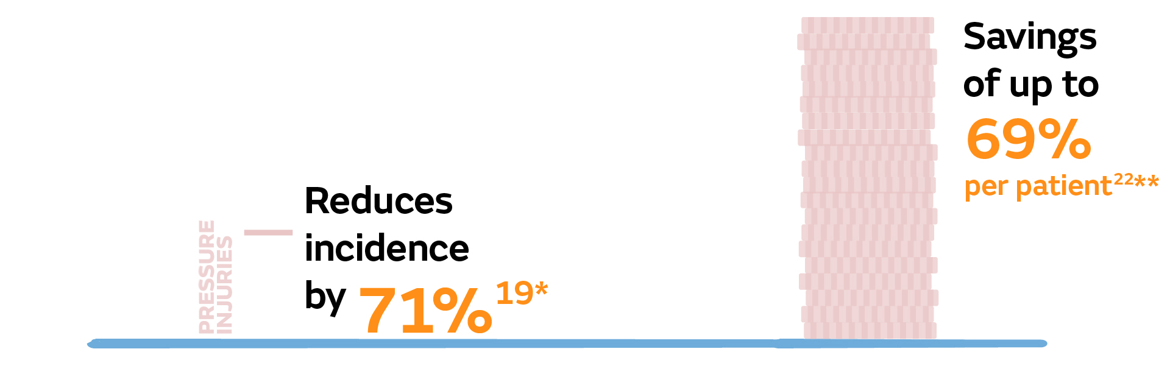
Reducing pressure injury incidence
ALLEVYN◊ LIFE Dressings help reduce pressure injury incidence,¹⁶⁻¹⁸ lowering the per patient cost associated with treating pressure injuries when compared to standard preventive care alone.¹⁹
SACRAL PRESSURE INJURIES ESTIMATED COSTS
¹⁹
16
*p=0.001; when used as part of a comprehensive prevention program and when compared to standard care alone
**Range of estimated cost savings (37-69%) n=359

Slide 11
References
Boyko TV, Longaker MT, Yang GP. Review of the current management of pressure ulcers. Adv Wound Care. 2018;7(2):57–67.
European Pressure Ulcer Advisory Panel, National Pressure Injury Advisory Panel and Pan Pacific Pressure Injury Alliance. Prevention and treatment of pressure ulcers/injuries: quick reference guide. Emily Haesler (Ed.). EPUAP/NPIAP/PPPIA: 2019.
Li Z, Lin F, Thalib L, Chaboyer W. Global prevalence and incidence of pressure injuries in hospitalised adult patients: A systematic review and meta-analysis. Int J Nurs Stud. 2020;105:103546.
Wassel C, Delhougne G, Gayle J, et al. Risk of readmissions, mortality, and hospital-acquired conditions across hospital-acquired pressure injury (HAPI) stages in a US National Hospital discharge database. Int Wound J. 2020; 1–11.
Langemo DK, Melland H, Hanson D, Olson B, Hunter S. The lived experience of having a pressure ulcer: a qualitative analysis. Adv Skin Wound Care. 2000;13:225–235.
Smith+Nephew 2023. The ALLEVYN™ LIFE Heel Foam Dressing as an energy absorber. CSD.AWM.23.033.
Smith+Nephew 2016. Permeability of Hydrophillic Polyurethane Film when in contact with water and water vapour (ALLEVYN LIFE). Internal Report. RD/16/019.
Tiscar-González V, Menor-Rodríguez MJ, Rabadán-Sainz C, et al. Clinical and Economic Impact of Wound Care Using a Polyurethane Foam Multilayer Dressing. Adv Skin Wound Care. 2021;34(1):23-30.
Smith+Nephew 2016 .Wound Model Testing of New ALLEVYN Life Gen2 wcl Dressing using Horse Serum at a Flow Rate Modelling that of a Moderately Exuding Wound. DS/14/303/R.
Smith+Nephew 2016. New ALLEVYN Life Gen2 wcl - Physical Testing. Internal Report. DS/15/025/R.
Rossington A, Drysdale K, Winter R. Clinical performance and positive impact on patient wellbeing of ALLEVYN Life. Wounds UK. 2013;9(4):91 - 95.
Clarke R. Positive patient outcomes: The use of a new silicone adhesive foam dressing for pressure ulcer prevention and treatment. Paper presented at: CAET; 2013
Lisco C. Evaluation of a new silicone gel-adhesive hydrocellular foam dressing as part of a pressure ulcer prevention plan for ICU patients. Paper presented at: WOCN; 2013
Smith+Nephew 2019. Properties of ALLEVYN LIFE advanced wound care dressing that can contribute to the effective use as part of a Pressure Injury Prevention protocol. Internal Report. RD/19/177.
Smith+Nephew 2023. Pressure Redistribution Testing of the Individual Layers of ALLEVYN™ LIFE Foam Dressing. CSD.AWM.23.034

Slide 12
References
Forni C, D’Alessandro F, Gallerani P, et al. Effectiveness of using a new polyurethane foam multi-layer dressing in the sacral area to prevent the onset of pressure ulcer in the elderly with hip fractures: A pragmatic randomised controlled trial. Int Wound J. 2018; 15(3):383–390
Stankiewicz M, Gordon J, Dulhunty J, et al. A cluster-controlled clinical trial of two prophylactic silicone sacral dressings to prevent sacral pressure injuries in critically ill patients. WP&R Journal. 2019;27(1):21 - 26.
Austin M. Implementation of a Medical Device Related Pressure Injury Prevention Bundle: A Multidisciplinary Approach. Paper presented at: SAWC; 2019.
Forni C, Searle R. A multilayer polyurethane foam dressing for pressure ulcer prevention in older hip fracture patients: an economic evaluation. J Wound Care. 2020;29(2):120–127
This material is intended for healthcare professionals. For detailed product information, including indications for use, contraindications, precautions and warnings, please consult the product’s applicable Instructions for Use (IFU) prior to use.
Smith & Nephew Pty Ltd Australia T +61 2 9857 3999 F +61 2 9857 3900 www.smith-nephew.com/en-au
Smith & Nephew Ltd New Zealand T +64 9 820 2840 F +64 9 820 2841 www.smith-nephew.com/en-nz
◊Trademark of Smith & Nephew. All Trademarks acknowledged. © May 2025 Smith+Nephew. 43081-anz V1 05/25

